Slide 1
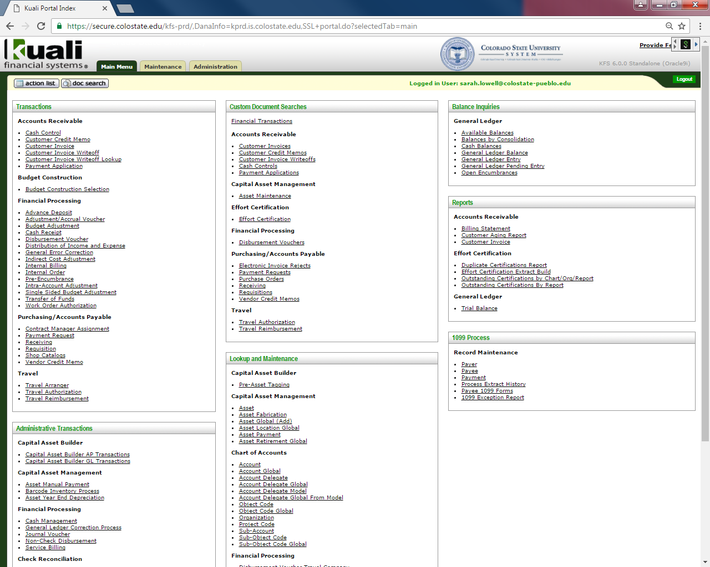
Travel Reimbursement -step by step-
When is Travel Reimbursement (TR) required?
All travel that requires reimbursement or travel advance issued on TA.
When is Travel Reimbursement not required?
No Cost Travel
Cancelled trip
Two ways to create TR document
New document (only In-State Travel)
New document from existing TA document

Slide 2
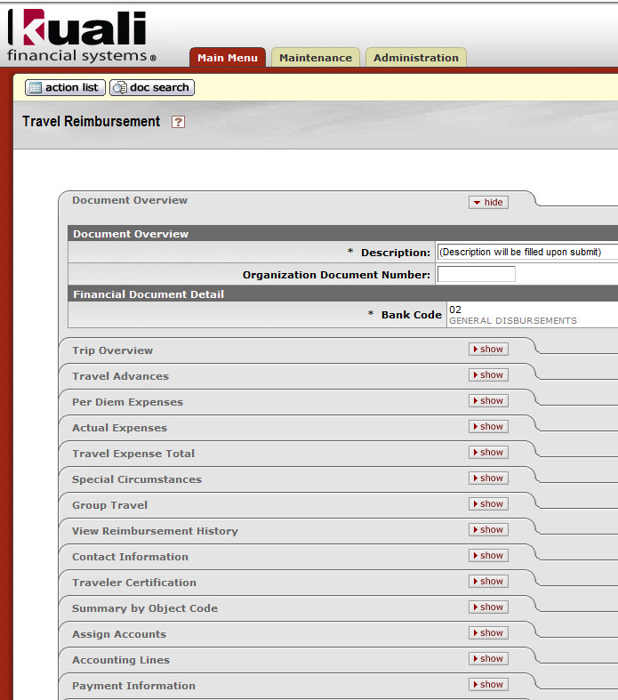
Travel Reimbursement -step by step-
Create new TR document (in-state travel)
Document Overview
Trip Overview
Travel Advances
Per Diem Expenses
Actual Expenses
Travel Expense Total
Special Circumstances
Group Travel
View Reimbursement History
Contact Information
Traveler Certification
Summary by Object Code
Assign Accounts
Accounting Lines
Payment Information

Slide 3
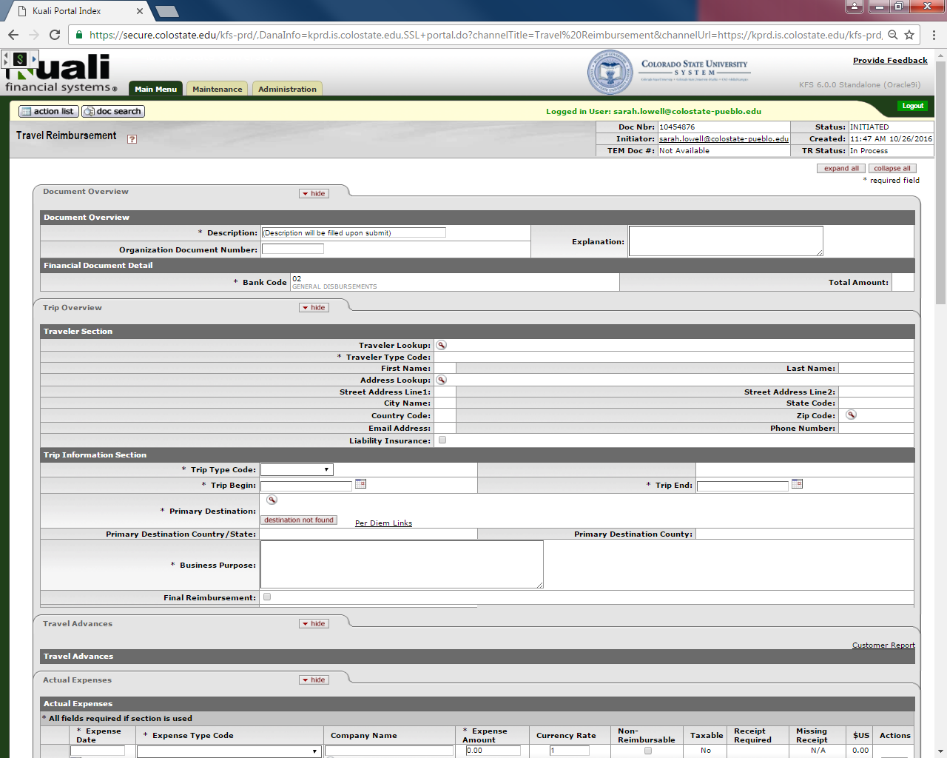
Document Overview Tab
Both required fields (Description and Bank Code) will auto fill after the Trip Overview tab is completed and the document is saved, do not fill these out
Explanation Box
The Purpose and Justification is entered in this field
Any additional notes or general Information about travel information should be entered here or in the Notes and Attachments section

Slide 4
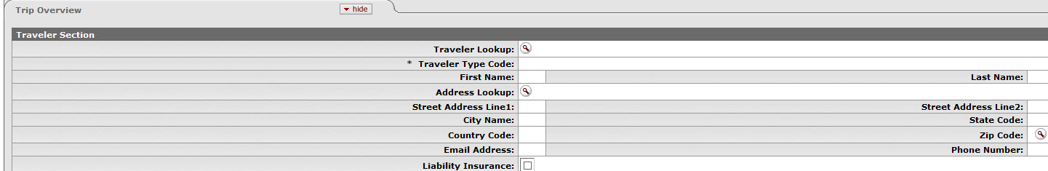
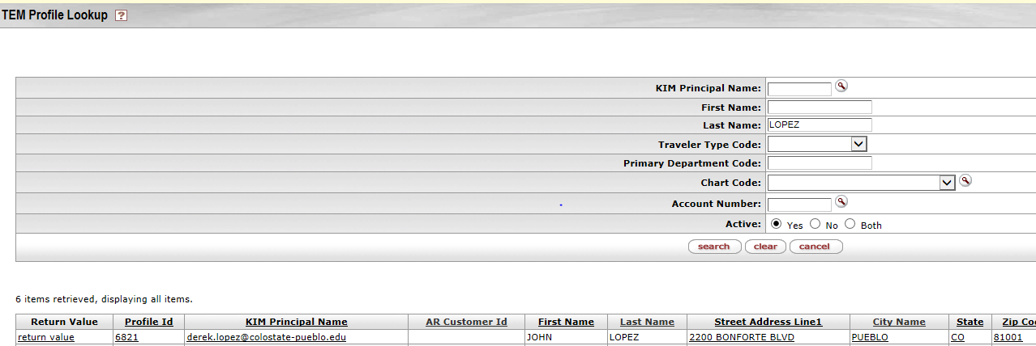
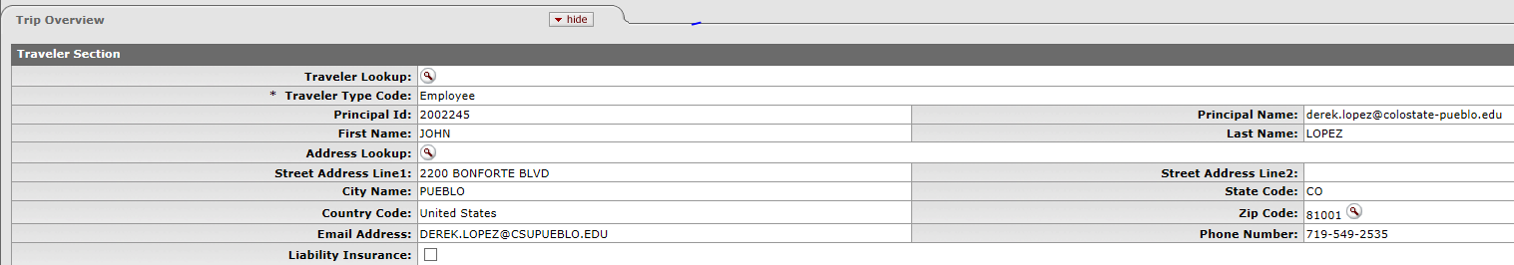
Trip Overview Tab
Traveler Section
Traveler Lookup
Clicking on the Magnifying Glass will redirect to TEM Profile lookup
If Traveler does not populate it could be one of the three items:
Their TEM Profile is not created, or
They are not in the system (not set up as A/R Customer), or
They are not set up as a Travel Arranger for them
To return traveler select “return value” to import traveler information
If you do not have the magnifying glass and your name is populating there, you are only able to do travel for yourself so you do not have and option to search for anyone

Slide 5
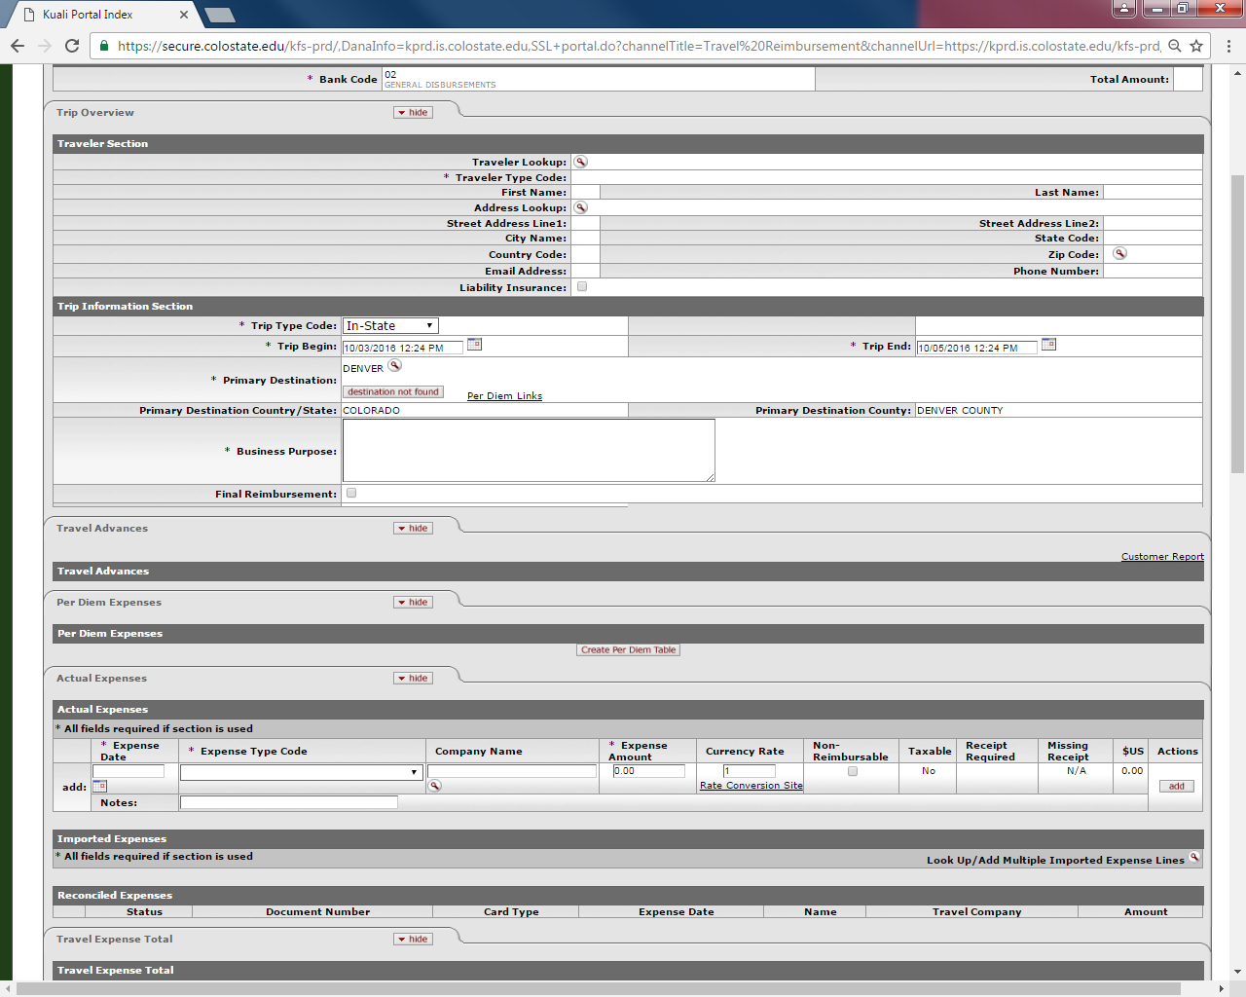
Trip Overview Tab
Trip Information Section
Trip Type Code
Trip Begin and Trip End
Primary Destination
Magnifying Glass allows search to return destination information
Per Diem Links – Provides link to State per diem webpage
Business Purpose
Input travel dates and destination
Final Reimbursement box- Check the box to remove the full encumbrance.
Travel Advances Tab
Tab will only be populated when creating Travel reimbursement from existing TA
Destination, Return Date

Slide 6
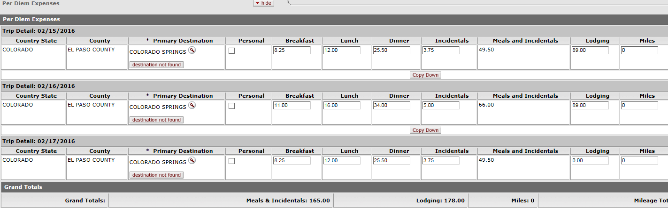
Per Diem Expenses Tab
Tab will only appear after Traveler section and Trip Information Section is entered and the document is saved, and you click “create per diem table”
Per Diem Expenses include Meals, Incidentals, Lodging, and Mileage
Lodging and Mileage can be entered on the Actual Expenses tab as well, but not on both tabs

Slide 7
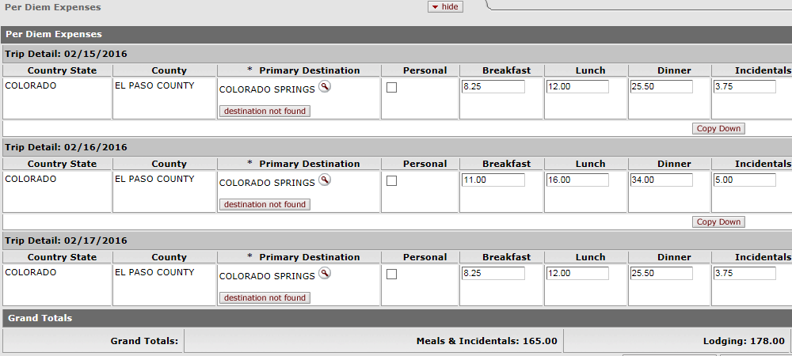
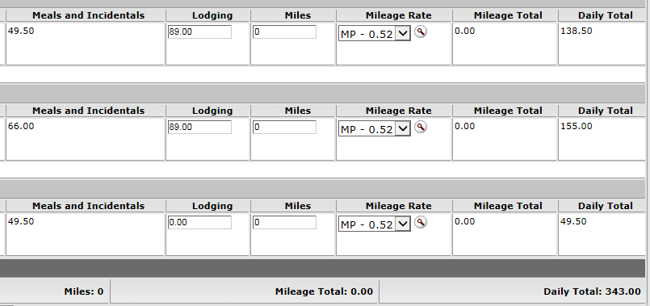
Per Diem Expenses Tab
Per Diem expenses default based on Destination
Per Diem meals can be changed, but the daily per diem amount cannot be increased
Mileage and Lodging amounts can be manually adjusted if necessary
The Copy down button will update the change to each line
Update Per Diem Table should be clicked after any changes made
Per Diem table can be removed by clicking “Remove Per Diem Table” button

Slide 8
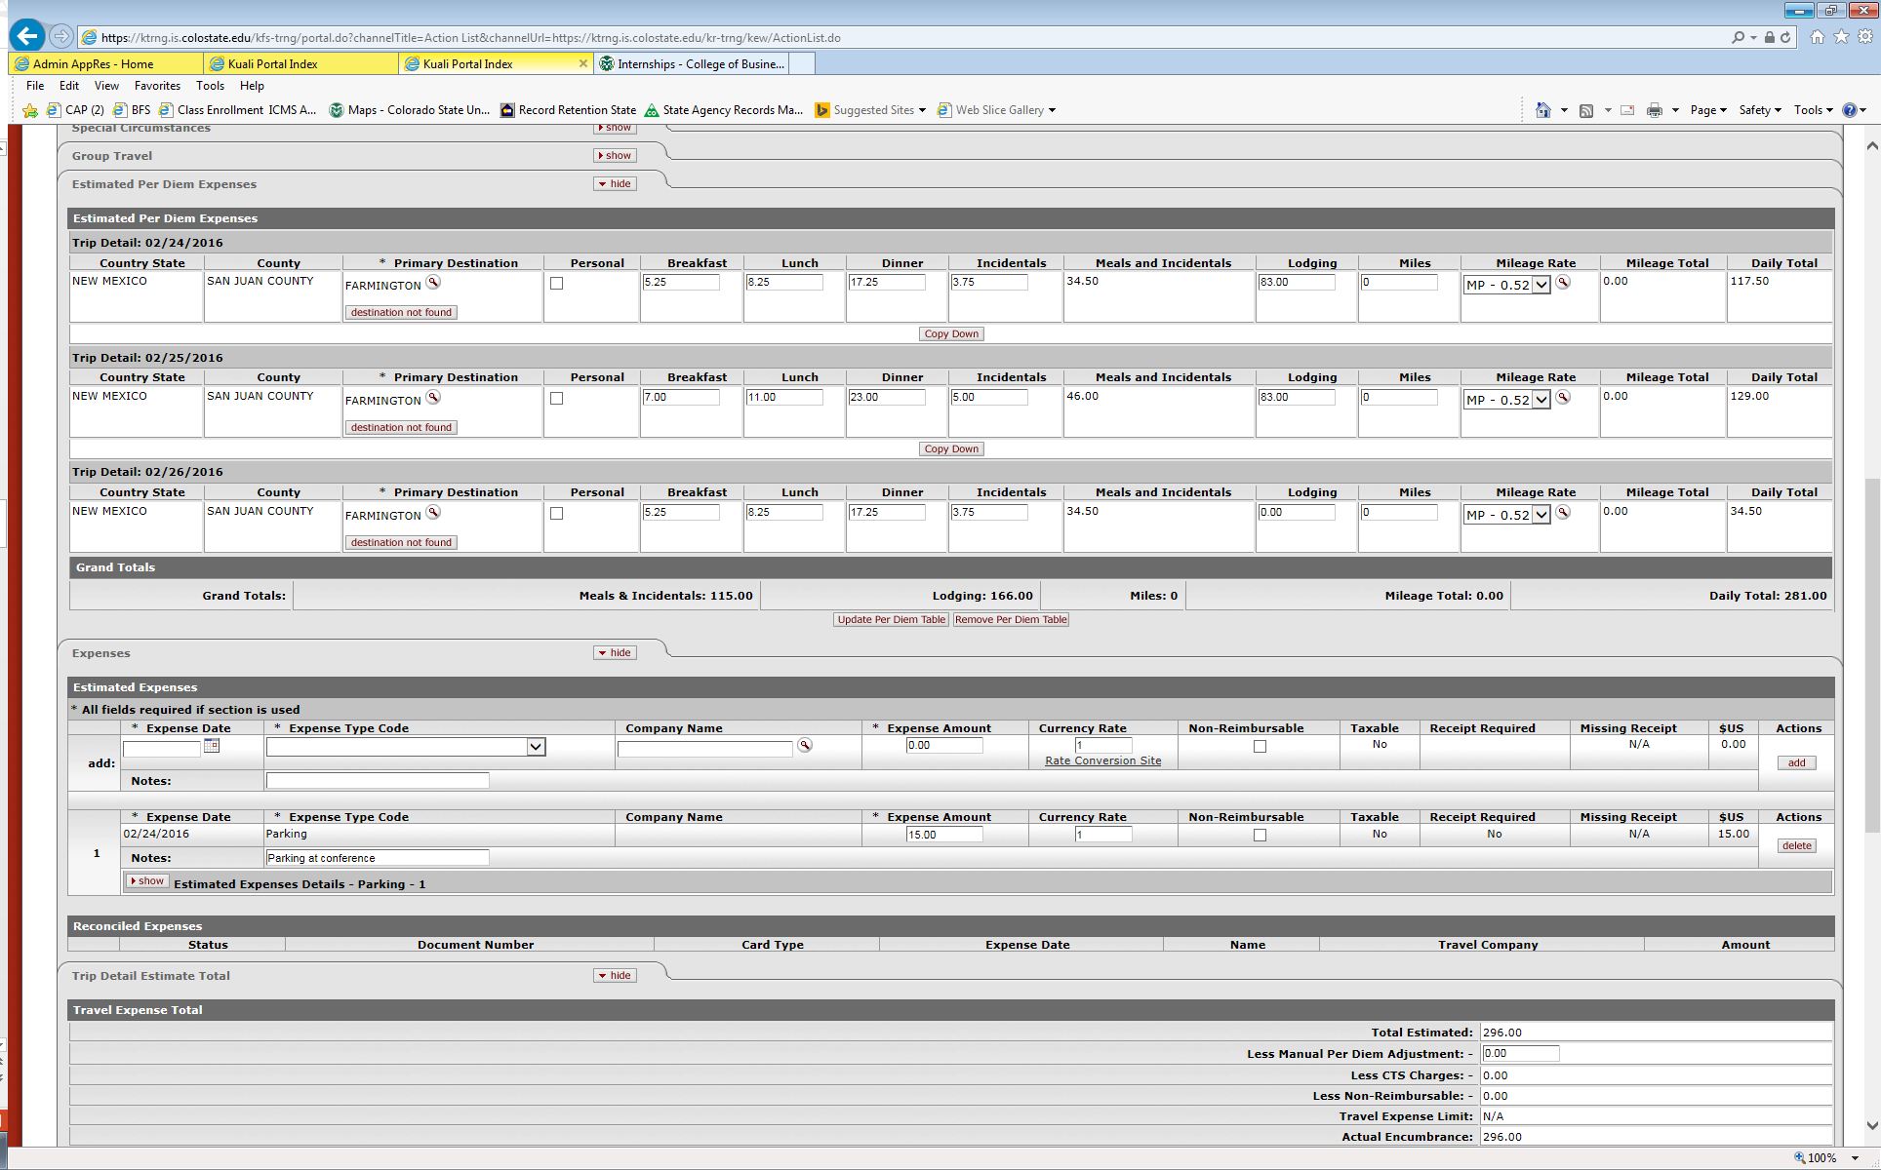
Actual Expenses Tab
All fields with asterisks are required fields
Expense Date
Expense Type Code
Expense Amount
Notes – this field is required even though it doesn’t have an asterisk
Rate Conversion Site
Opens link to Oanda conversion website
Just like other Kuali documents, be sure to click add button to save each expense

Slide 9
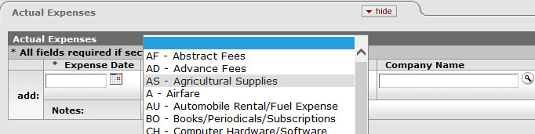
Travel REIMBURSEMENT -step by step-
Actual Expenses Tab
Expense Type Drop Down Box explains the type of expense

Slide 10
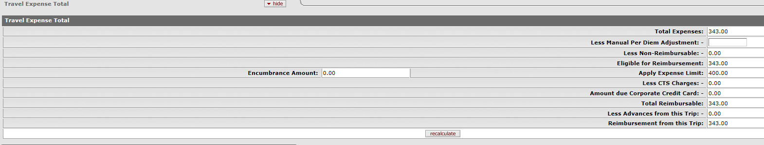
Travel Expense Total
Provides a summary of all the trip actual expenses
Allows for Manual Per Diem Adjustments
Notice Travel Expense Limit is carried over from the Special Circumstances Tab (400 in this example)
Total can be recalculated as necessary by clicking “recalculate” button
Encumbrance Amount is the amount that was encumbered on the TA related to this travel, the encumbrance amount will by $0.00 if there was not a TA done (in-state travel)

Slide 11
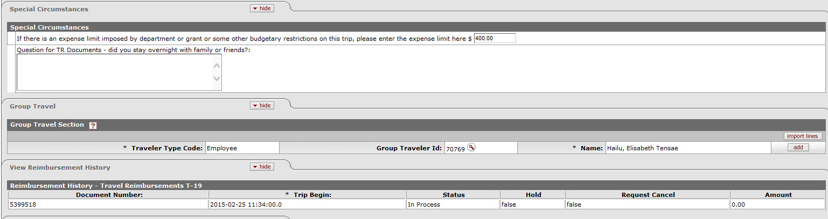
Special Circumstances Tab
Optional information such as dept. budget information and other misc. trip details
If Budget restrictions are entered here the amount is carried to the Trip Detail Estimate Total Tab
If lodging is entered in expense section and not per diem table, the justification for meals without lodging will be entered here
Group Travel Tab
Group Travelers can be added by using magnifying glass lookup and clicking add button
View Reimbursement History Tab
Shows reimbursement status (In Process in this case) and amount of reimbursement

Slide 12
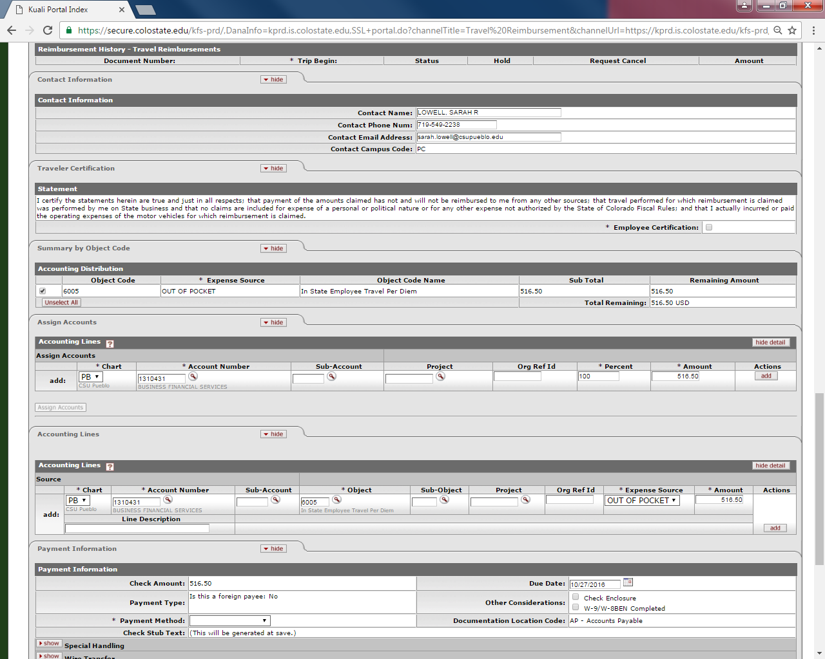
Travel Reimbursement -step by step-
Traveler Certification Tab
If traveler submits their own travel they will need to check this box prior to submitting.
If arranger submits travel the document will route to the traveler.
Traveler will need to open the document from their action list and check the certification box before reimbursement will be issued, then click approve.
Summary by Object Code
Expenses will be grouped by amount and object code for the accounting distribution
DO NOT TOUCH THIS SECTION

Slide 13
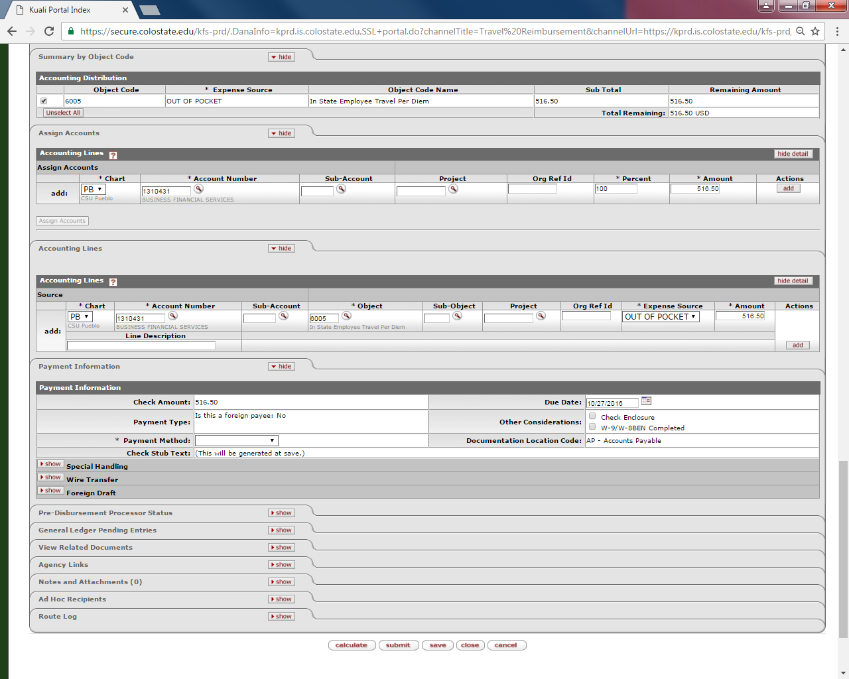
Assign Accounts Tab
All accounts to be used for reimbursement should be entered here
All percent allocation will be applied to accounts based on object code in the Accounting Lines Tab
Click “add” to add your accounts, and then click “Assign Accounts”
Accounting Lines Tab
All accounts will be added from the Assign Accounts Tab.

Slide 14
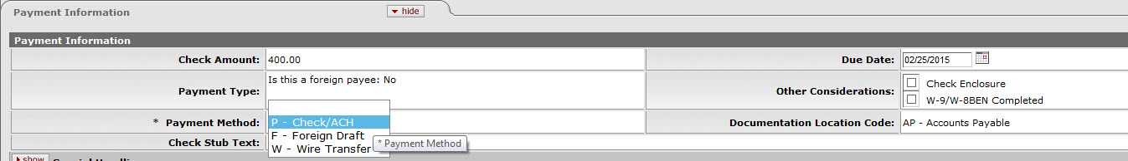
Travel Reimbursement -step by step-
Payment Information Tab
This tab is the same as the payment tab on a DV
Check Amount will auto populate
Payment method to choose from drop down box is P- Check/ACH
Select Check Enclosure box if you need a physical check to come to Pueblo Campus

Slide 15
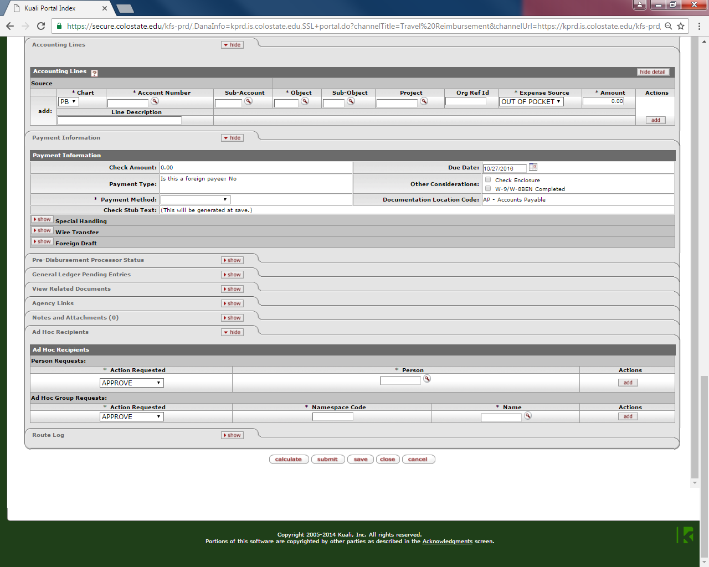
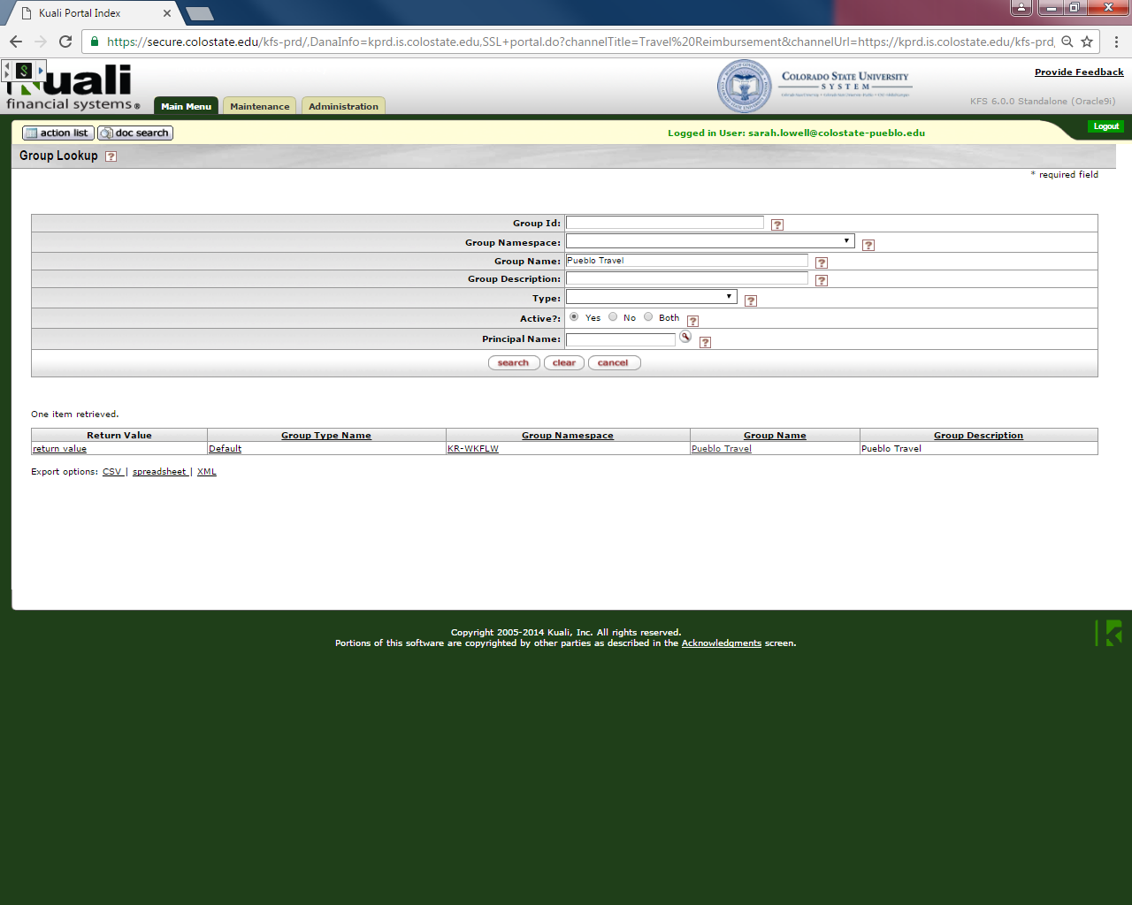
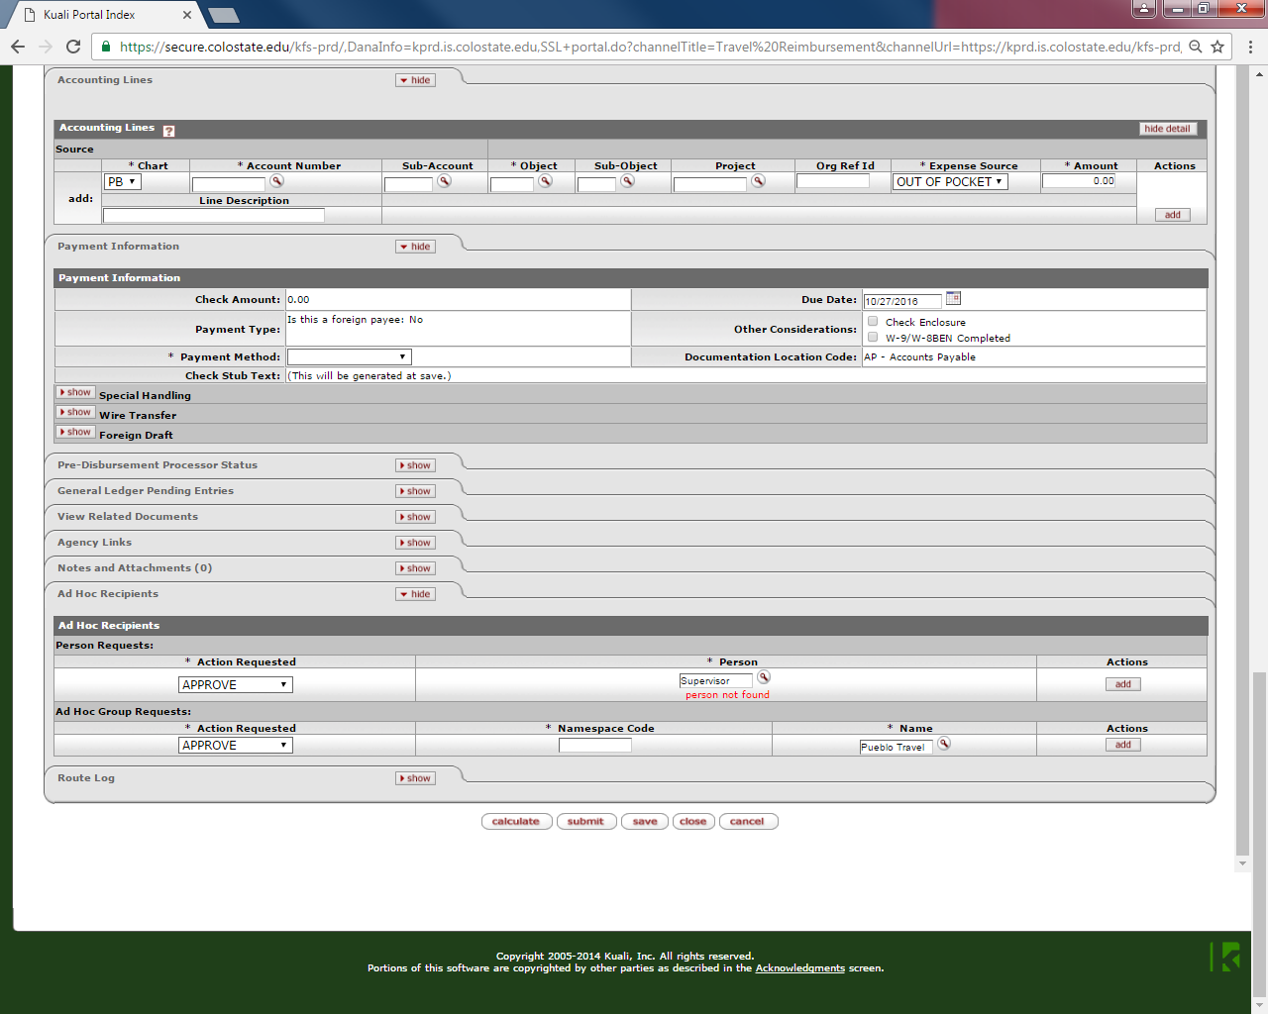
Routing
Ad Hoc Recipients
Documents will automatically route to the Fiscal Officer and Traveler but you MUST ad hoc the group “Pueblo Travel” in the group ad hoc section as “Approve.” If the Fiscal Officer is not the Supervisor for the traveler an “Approve” or “FYI” ad hoc request will also need to be sent to them by searching for their name.

Slide 16
Travel Reimbursement -step by step-
For Out-of-State, International, Travel Advance, Ghost-Card Purchase Trips
Create new TR document from existing TA
A new TR document is created and auto filled from the TA document
Document should be verified for accuracy
Actual expenses can be entered so the proper reimbursement amount can be made
Follow step-by step instructions from slides 3-15 to complete TR

Slide 17
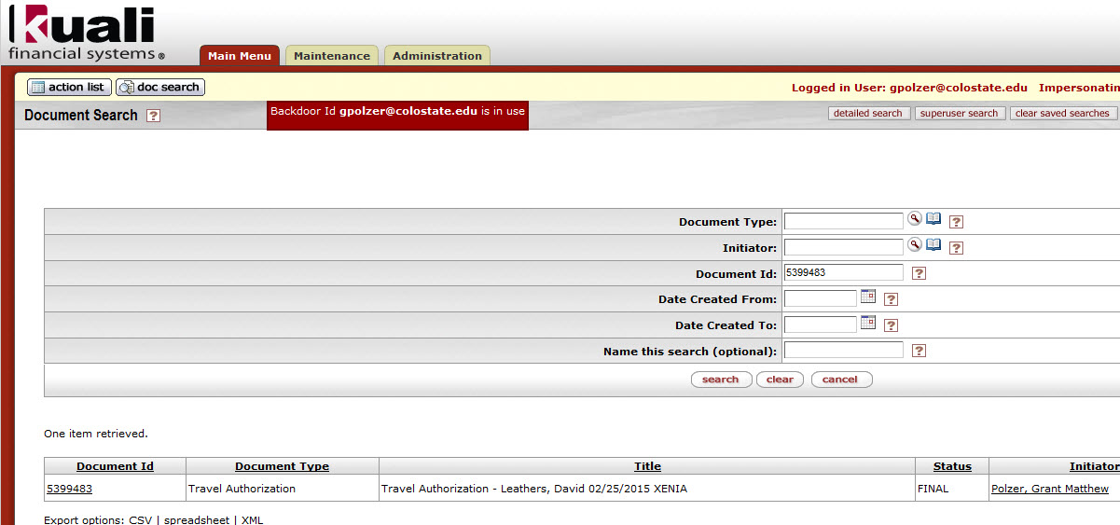
Travel Reimbursement -step by step-
Create TR from Existing TA
Open TA document that has not been reimbursed by using the doc search button
Enter document number in the document ID field
Choose document under the Document ID field to Import into the TR

Slide 18
Travel Reimbursement -step by step-
Information is pulled from the TA document and many tabs will auto fill
Enter document number in the document ID field
Choose document under the Document ID field to open the TA document

Slide 19
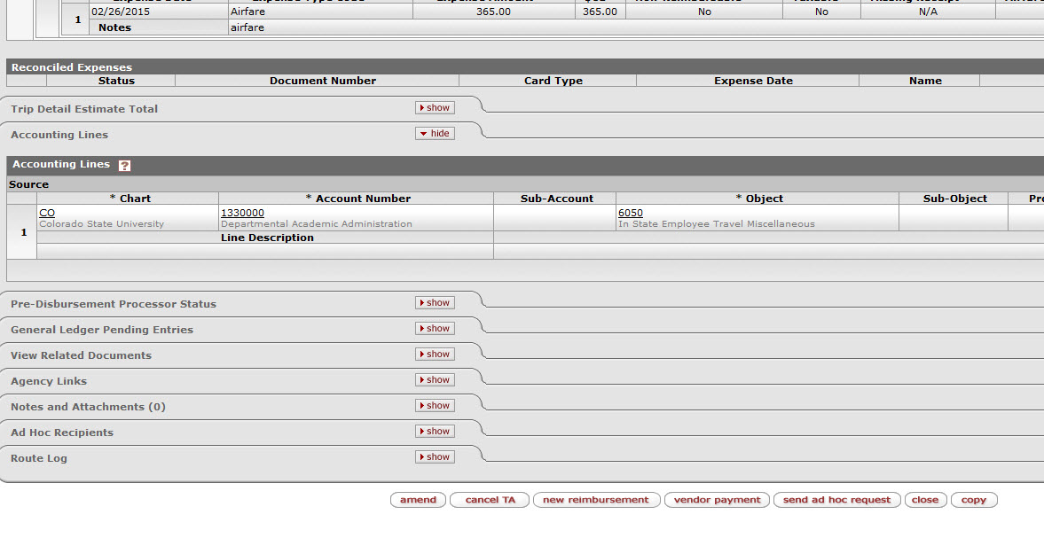
Travel Reimbursement -step by step-
Create new TR document from existing TA
All information will auto populate
At the bottom of the screen click on “new reimbursement” button to open TR document

