Slide 1
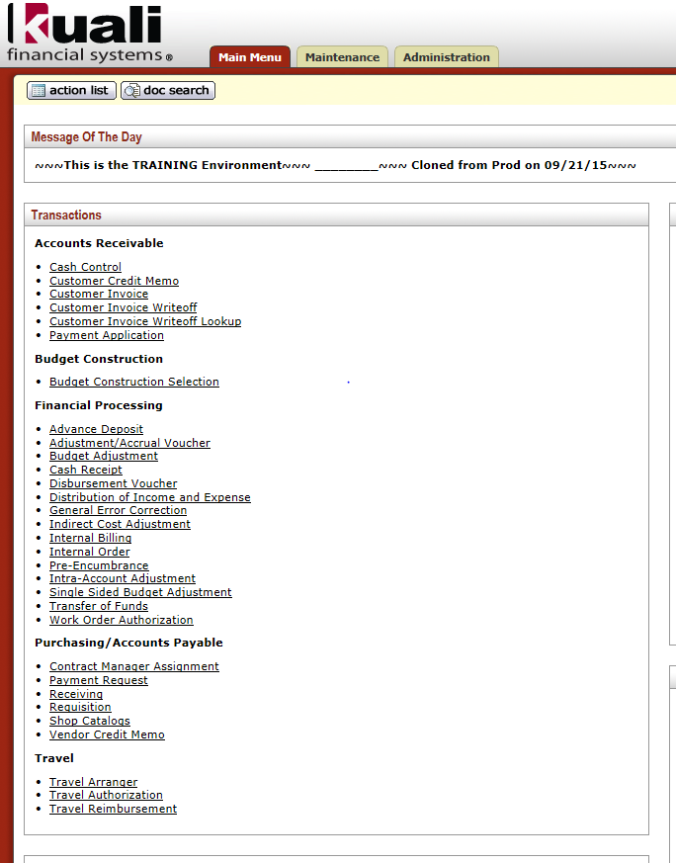
Travel Authorization -step by step-
When is Travel Authorization required?
Any travel that has a travel advance request
All Out-of-State and International travel
All travel with Ghost Card airfare
When is Travel Authorization not required?
All in State Travel that is covered by Blanket Approval

Slide 2
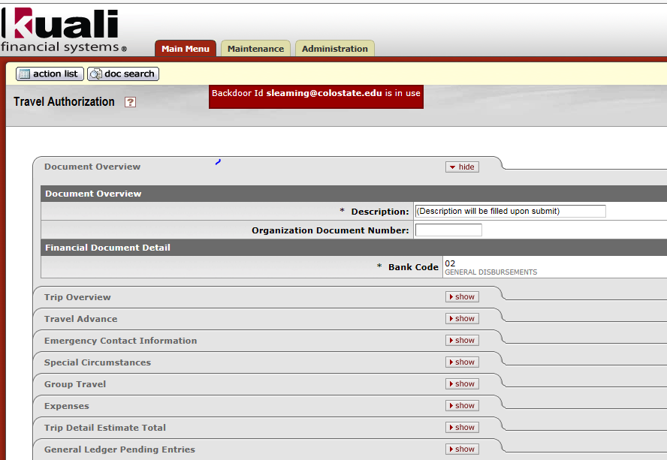
Travel Authorization -step by step-
Travel Authorization document has ten unique tabs
Document overview
Trip Overview
Travel Advance
Emergency Contact Information
Special Circumstances
Group Travel
Estimated Per Diem Expenses
Expenses
Trip Detail Estimate Total
Accounting Lines
This section pulls in the account number from the Traveler’s TEM Profile, but can be changed to any account number
The document will route to the account number used in this section

Slide 3
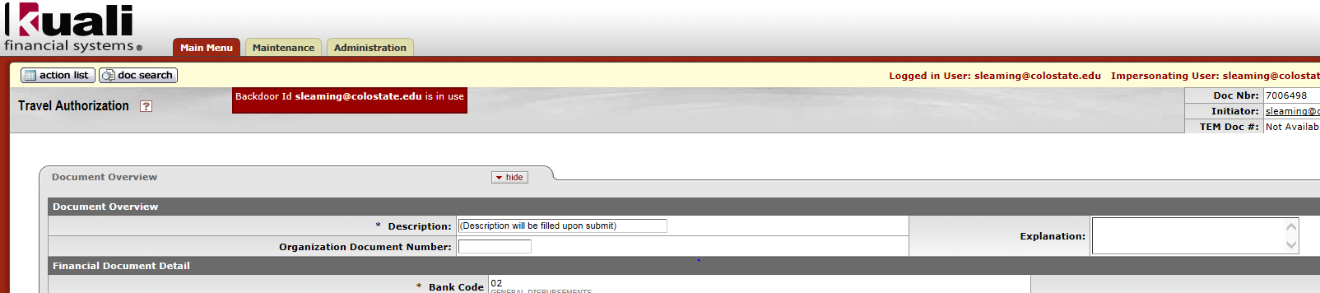
Travel Authorization -step by step-
Document Overview Tab
Field with Asterisks required
Both required fields and Org document number will auto fill after the Trip Overview tab is completed and the document is saved, so do not fill this out
Description Field
Org Document number
Bank Code
Explanation Field
Trip justification and purpose is entered here

Slide 4
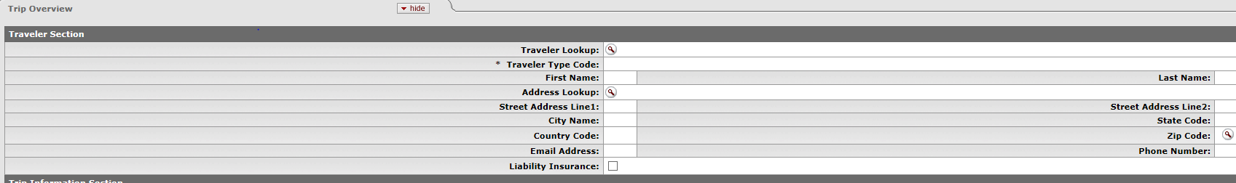
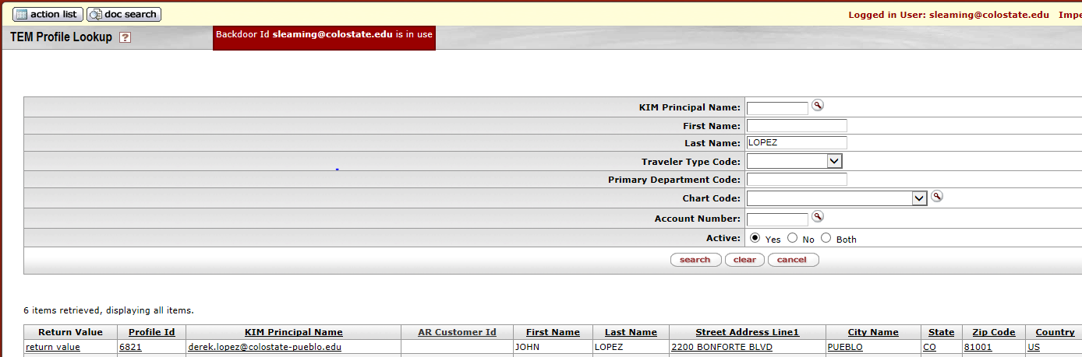
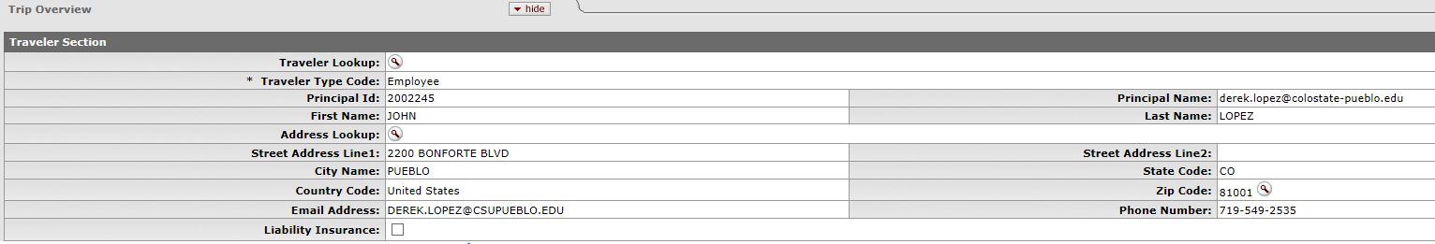
Travel Authorization -step by step-
Trip Overview Tab
Traveler Section
Traveler Lookup
Clicking on Magnifying Glass will redirect to TEM Profile Lookup
If Traveler does not populate it could be one of the three items:
Their TEM Profile is not created, or
They are not in the system (not set up as A/R Customer), or
You are not set up as a Travel Arranger for them
To return traveler select “return value” to import traveler information
Liability Insurance box is never used, so do not check the box

Slide 5
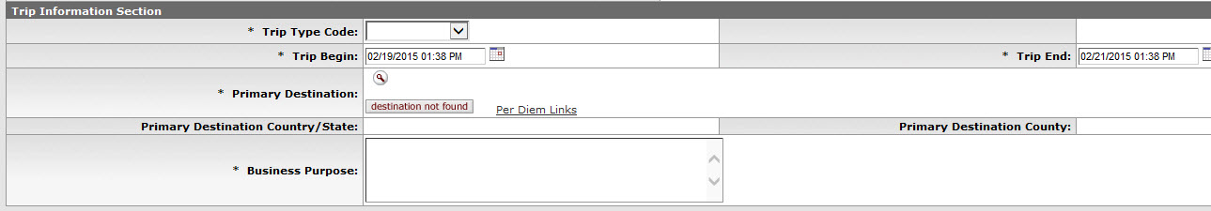
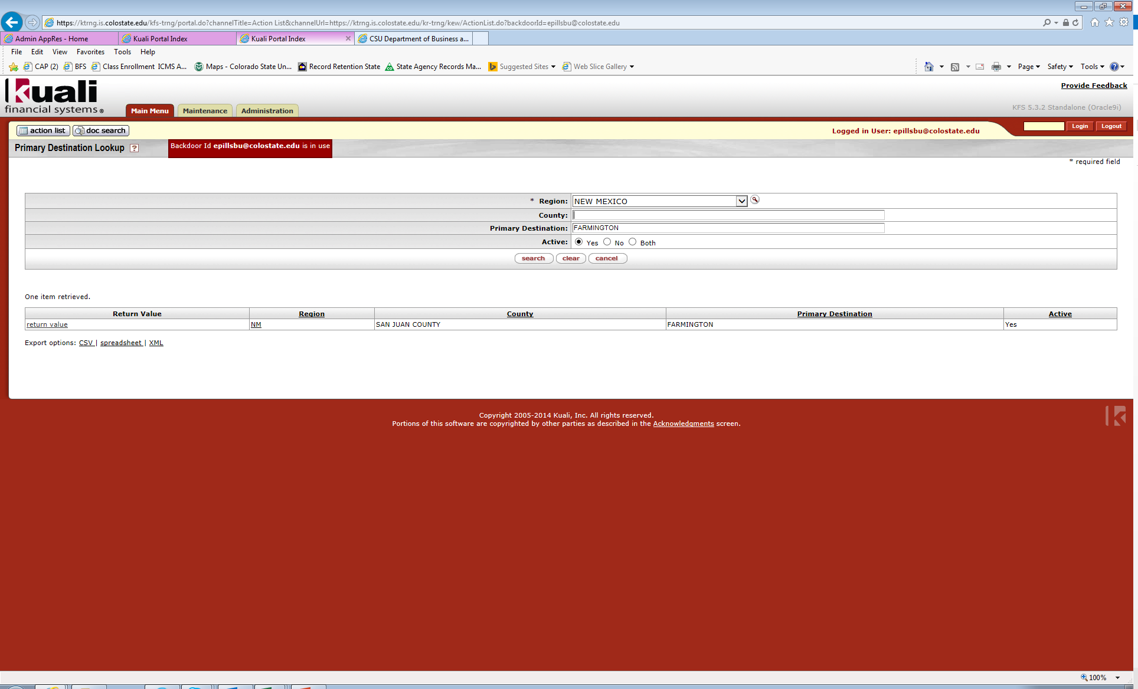
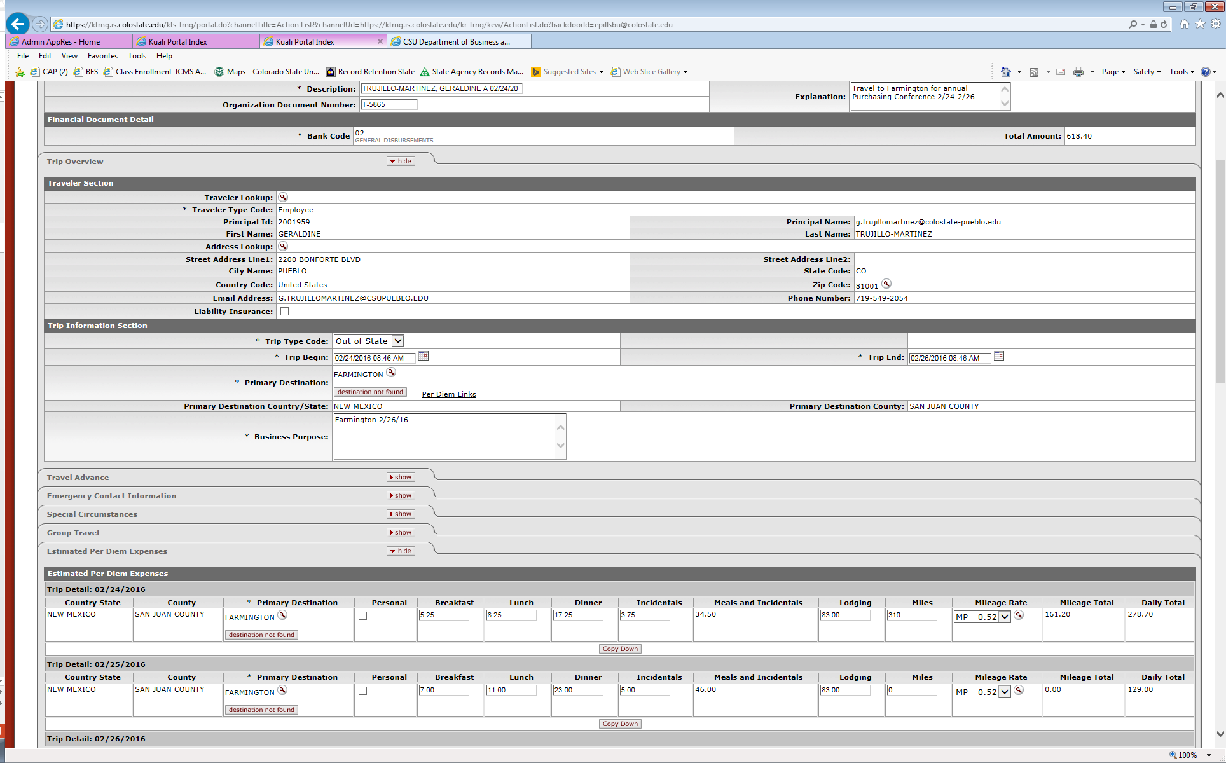
Travel Authorization -step by step-
Destination, return date
Trip Overview Tab
Trip Information Section
Trip Type Code
Select trip type from drop down box
In-State, Out-of-State, International
Trip Begin and Trip End (time of day does not affect per diem amounts)
Primary Destination
Magnifying Glass allows search to return destination information
Region must be selected (state or country)
To return information click “return value”
Per Diem Links – Do not use, Per diem will be entered on separate tab, this takes you to the state website with per diem rates
Business Purpose
Put trip destination and return date
This populates on the check, so do not want to use special characters or make this section really long

Slide 6
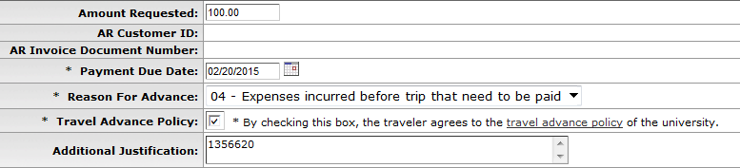
Travel Advance tab (only use if requesting travel advance)
Amount Requested – enter amount traveler is requesting to be advanced
Payment Due Date – date check will be issued
No more than 10 days before trip begin date (Pueblo Travel Office will ensure it is within the 10 day window)
Must be dated today or later, but no later than the trip end date
Reason For Advance – select from drop down menu options
Travel Advance Policy – traveler must check the box to agree with the travel advance policy; clicking the travel advance policy link takes the traveler directly to the posted policy
If employee, the traveler must check the box
If non-employee student, the Travel Arranger can check the box on their behalf
Travel Advance is the only time a traveler will be required to take action on a TA
Additional Justifications – entry required here when the “Other” option is selected from the Reason For Advance field and includes
Account number the travel advance should be cleared against, and additional justification for why “other” was selected

Slide 7
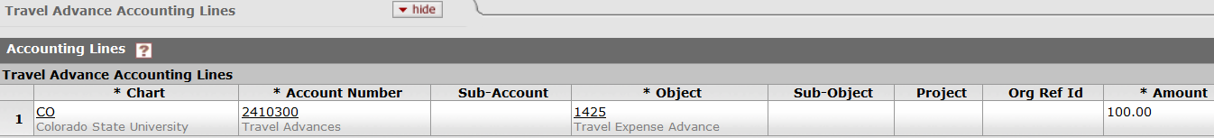
Travel Authorization -step by step-
This tab requires no entry by the document initiator, and is display only. Account Number 2410300 is the Travel Advances account in Chart Code CO; the Amount will populate based on user entry from the Travel Advance tab once the document is either recalculated, saved or submitted. This account number cannot be changed. If traveler doesn’t use all the advance then a Cash Receipt will be done this account and object code to remove the balance, and is references in the TR so the credit memo can be done to clear.
Traveler must have a default account number designated in their TEM profile

Slide 8
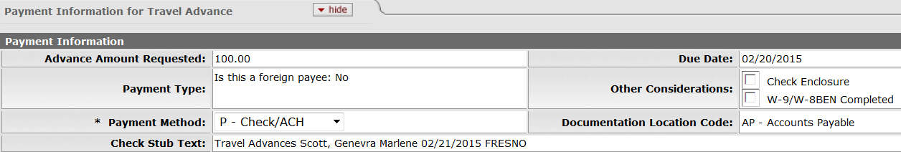
Travel Authorization -step by step-
Payment Information for Travel Advance Tab
Advance Amount Requested – will populate after “calculate” button clicked
Payment Method – select from drop down menu choices; most cases use P - Check/ACH; no additional entry required by document initiator
Special Handling, Wire Transfer, and Foreign Draft – not to be used
Check Enclosure – if check needs to be cut instead of ACH check this box and in the notes section explain you need a check instead of ACH

Slide 9
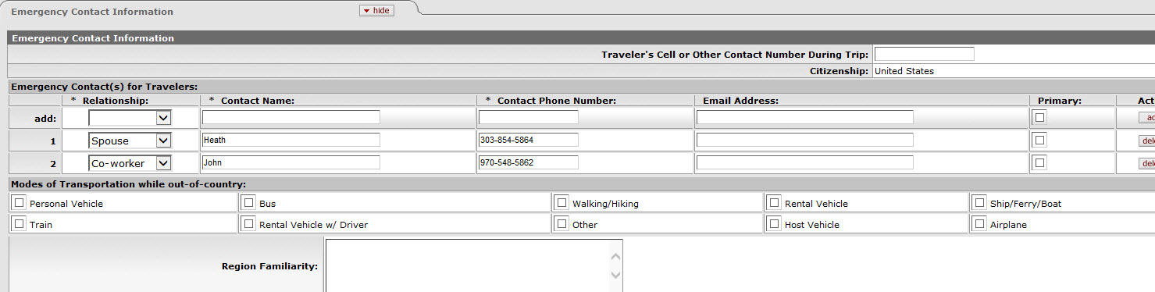
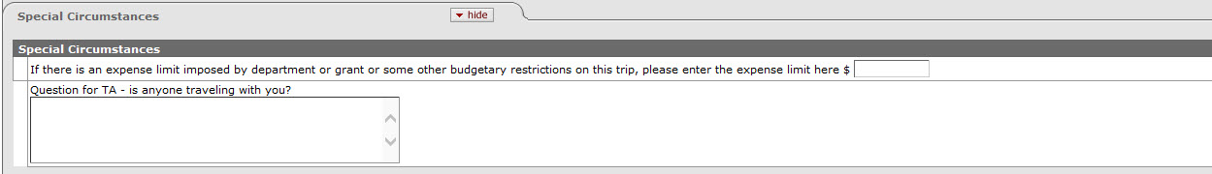
Travel Authorization -step by step-
Emergency Contact Tab
Emergency Contact Information imported from TEM Profile
Additional Contacts may be added
If traveling internationally must input a number for “Traveler’s Cell or Other Contact Number During Trip”
Special Circumstance Tab
Optional information such as dept. budget information and other misc. trip details
If Budget restrictions are entered here the amount is carried to the Trip Detail Estimate Total Tab
If lodging isn’t entered in the per diem section, but in the expense section you need to complete the “justification for meals without lodging” in this section. You will enter “lodging for trip is combined on one line”

Slide 10
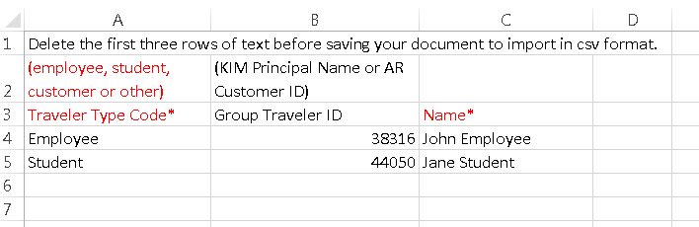
Travel Authorization -step by step-
Group Travel Tab
Two methods for adding travelers
Manually add each traveler (excluding main traveler)
Import lines feature
Attach excel document with list of group travelers
Manually Add Each Traveler
Traveler Type Code – select from drop down menu
Employee
Student
Customer
Other
Group Traveler Id
Select from list of KFS users
Name
Import Lines Feature
Click the question mark icon to download template
Save template as csv file
Browse for template and click add
If Group Traveler is not in the System, an excel list can be added in the Notes & Attachments section (does not include employees)

Slide 11
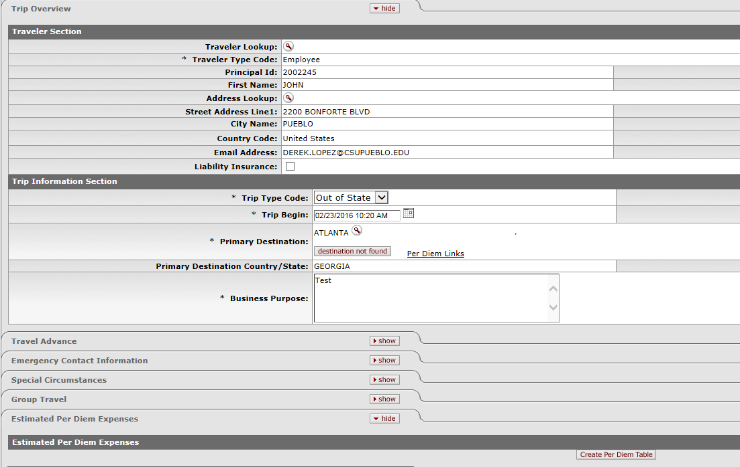
Estimated Per Diem Exp. Tab
Tab will only appear after Traveler section and Trip Information Section is entered and the document is saved
Per Diem Expenses include Meals, Incidentals, Lodging, and Mileage
Lodging and Mileage can be entered on the Expenses tab as well, but not on both tabs
If lodging is entered on Expense tab as one line/date, then you will be required to fill out the “Justification for meals without lodging” in the Special Circumstances section. It can be completed with “lodging for trip is combined on one line”
To create a per diem table click on the “Create Per Diem Table” button on the Estimated Per Diem Expenses Tab

Slide 12
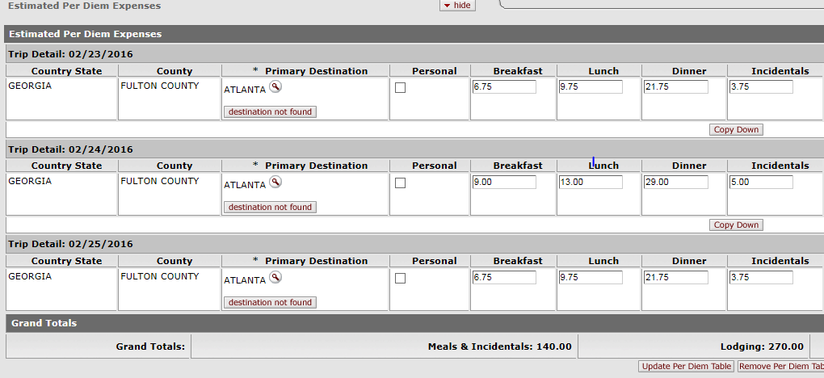
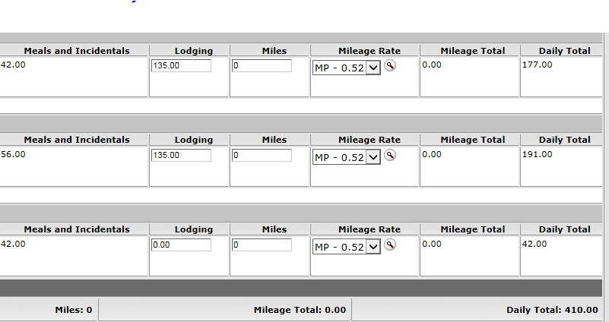
Estimated Per Diem Exp. Tab
Per Diem expenses default based on Destination
If traveling to multiple locations, the destination can be changed on each day in the per diem table if applicable
Amounts can be manually adjusted if necessary, but cannot be increased more than the daily per diem rate
The Copy down button will update the change to each line (excluding the meals)
Update Per Diem Table should be clicked after any changes made
Recommend using for mileage
Per Diem table can be removed by clicking “Remove Per Diem Table” button

Slide 13
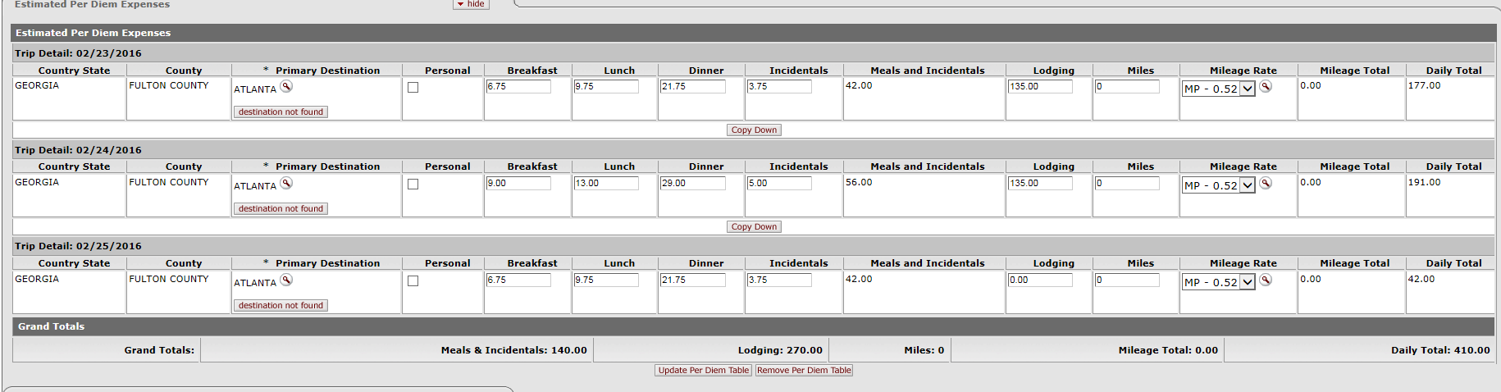
Travel Authorization -step by step-
Estimated Per Diem Exp. Tab

Slide 14
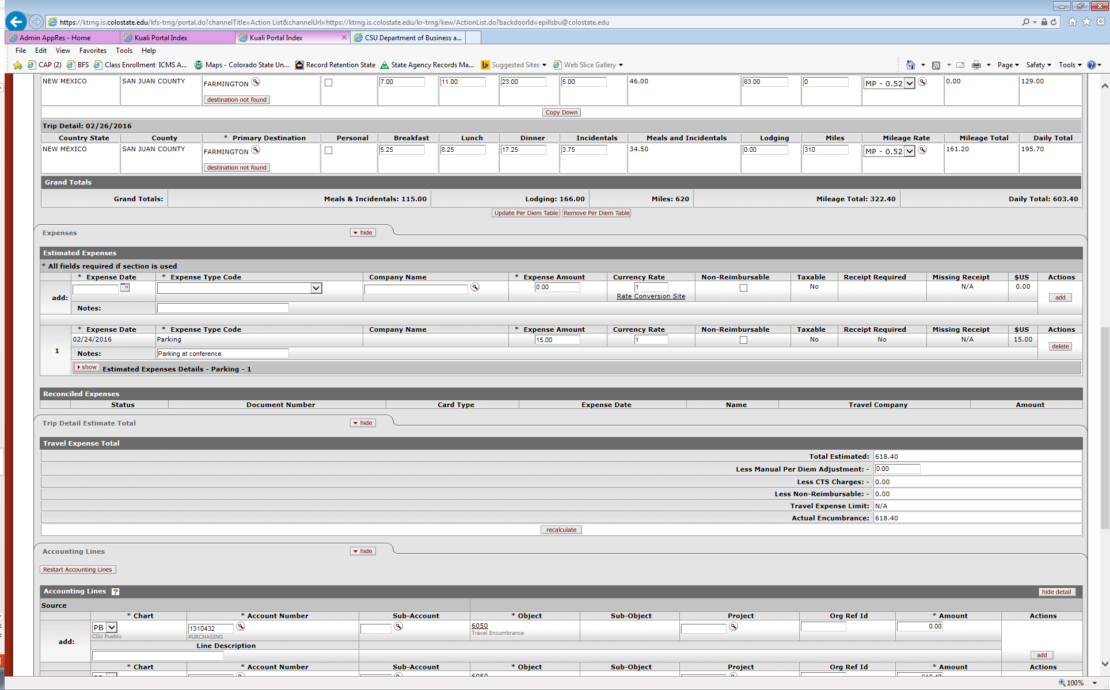
Travel Authorization -step by step-
Expenses Tab
All fields with asterisks are required fields
Expense Date
Expense Type Code
Expense Amount
Notes – must fill out this section even though there is not an asterisk
Rate Conversion Site
Opens link to Oanda conversion website
Non-Reimbursable can be checked with the traveler is not to be reimbursed for the expense (i.e. ghostcard)
Just like other Kuali documents, be sure to click add button to save each expense

Slide 15
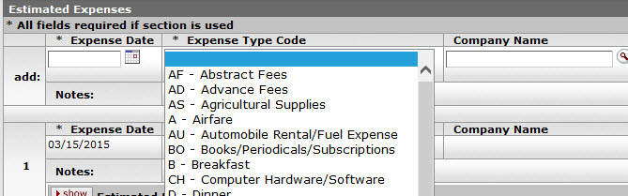
Travel Authorization -step by step-
Expenses Tab
Expense Type Drop Down Box lets you choose the type of expense

Slide 16
Travel Authorization -step by step-
Expenses Tab
Notice expense amounts saved as they are added

Slide 17
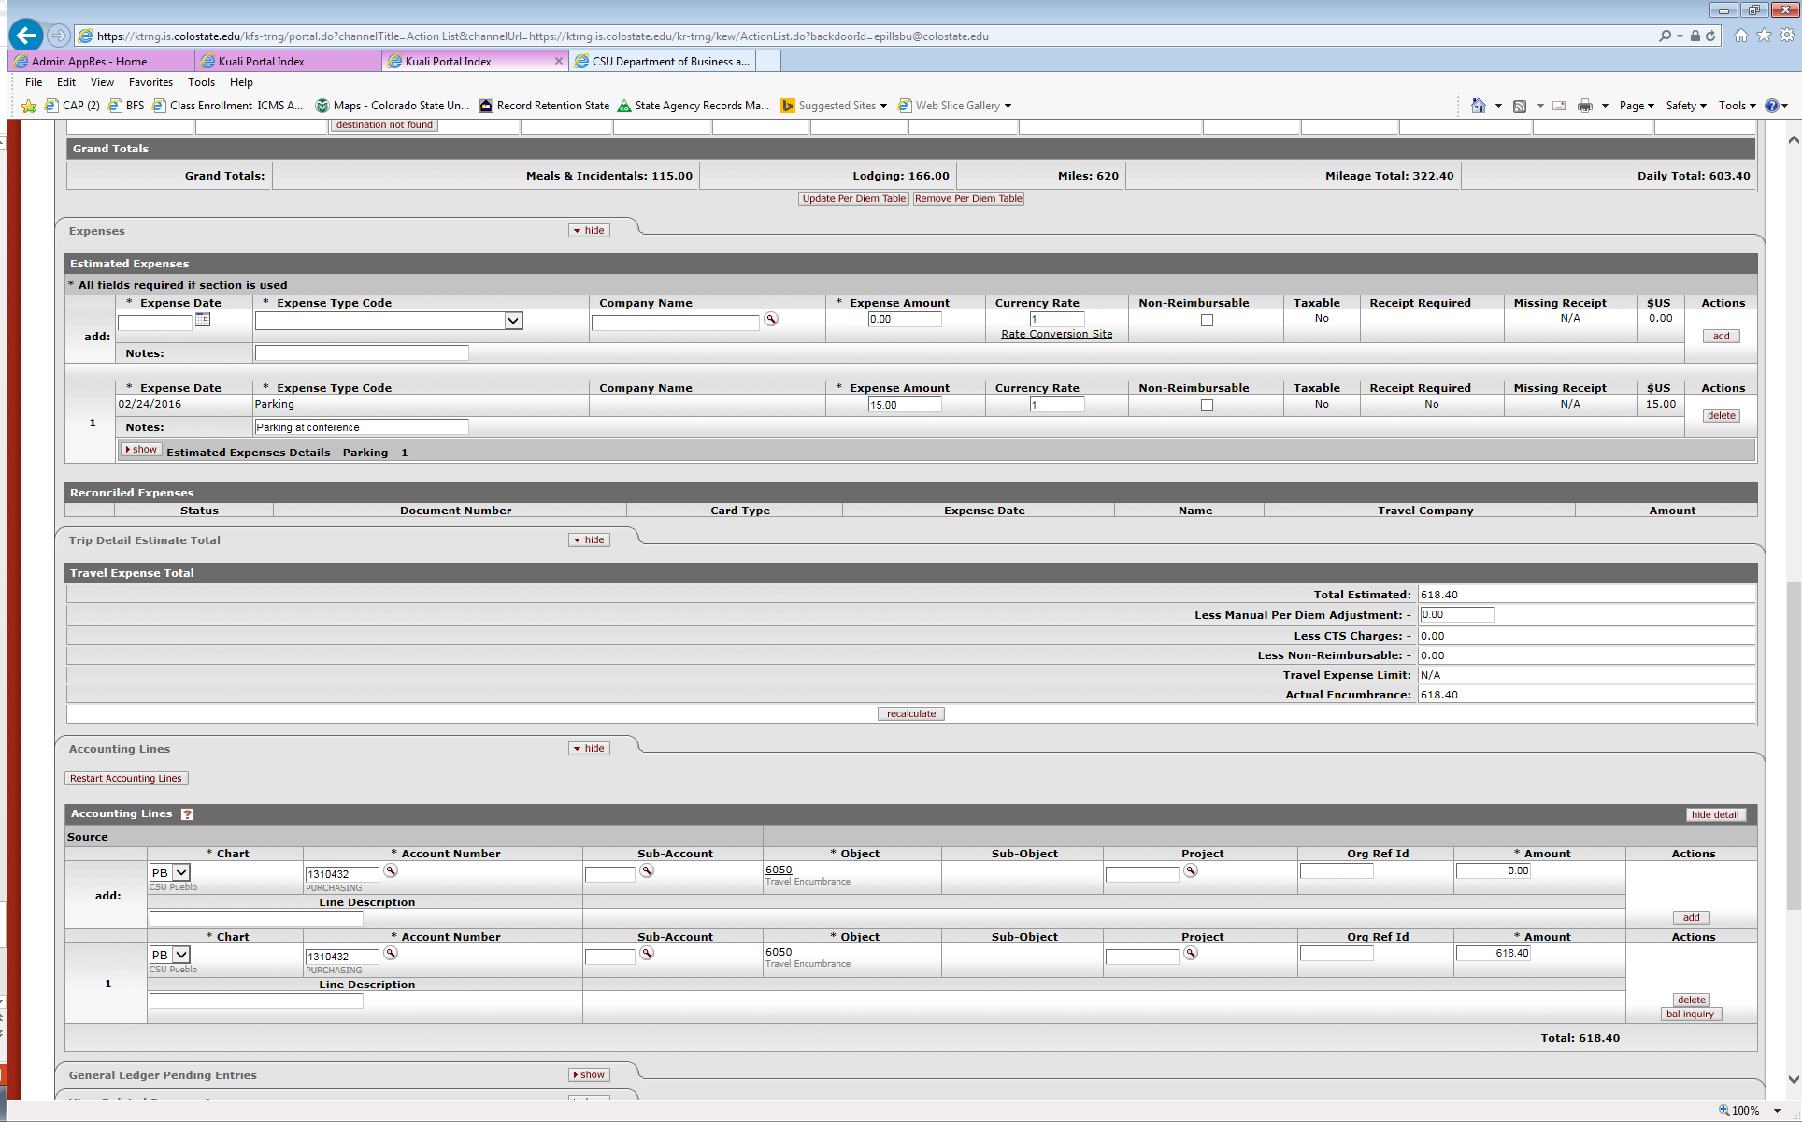
Travel Authorization -step by step-
Trip Detail Estimate Total Tab
Provides a summary of all the estimated expenses and encumbrances
Allows for Manual Per Diem Adjustments
Travel Expense Limit – if one is entered then it carries here and does not let the traveler be reimbursed above that amount regardless of total expenses
Total can be recalculated as necessary by clicking “recalculate” button

Slide 18
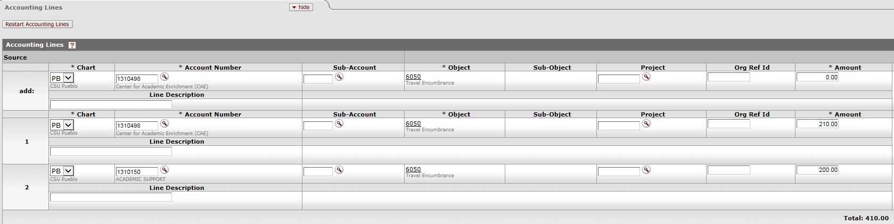
Travel Authorization -step by step-
Accounting Lines Tab
Account Number will default to account associated with traveler TEM Profile
This can be changed to any account in this section
Multiple accounts can be added for split funding
Will not pull forward on TR document
TA accounting lines only use object code 6050-Travel Encumbrances since this only books the encumbrance and not actual expenses
Default account from TEM Profile
Account added for split funding

Slide 19
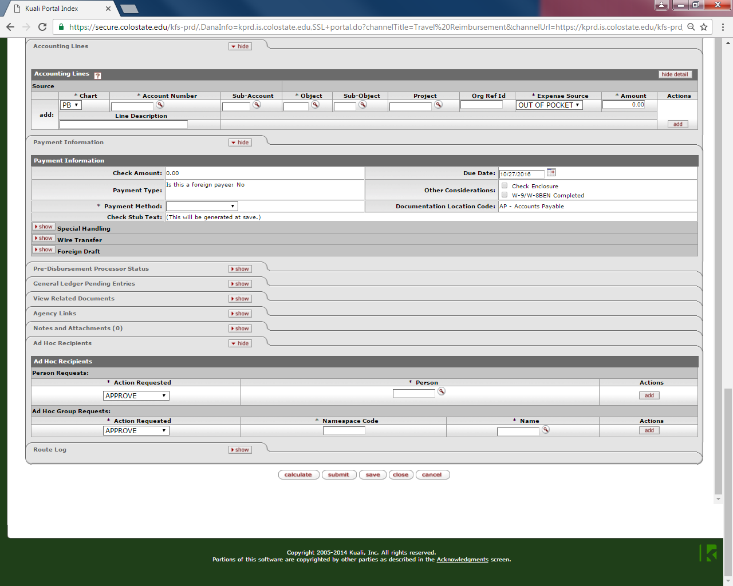
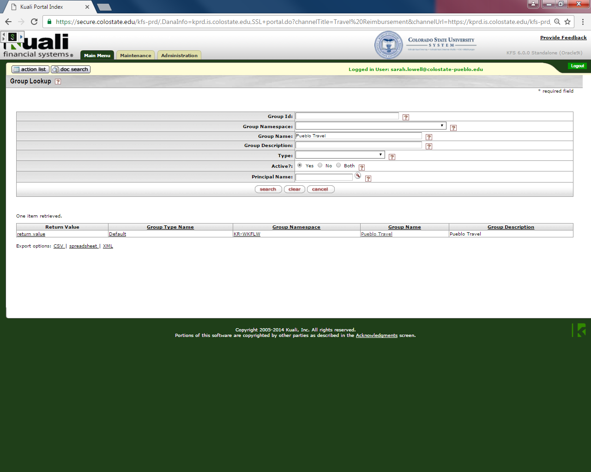
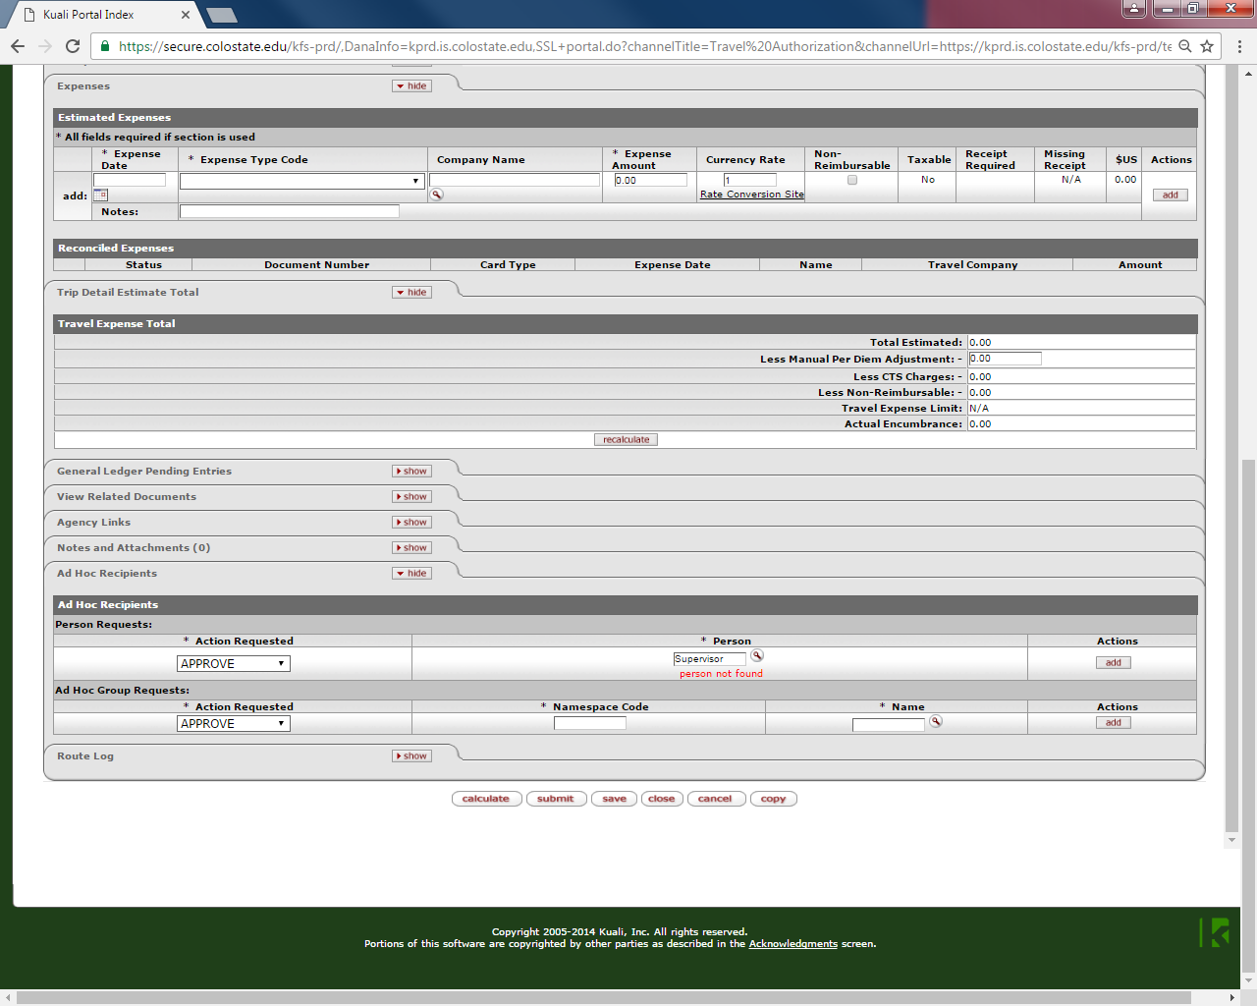
Travel Authorization -step by step-
Ad Hoc Recipients
Document will automatically route to Fiscal Officer and Traveler (only for travel advance). If the Fiscal Officer is not the traveler’s Supervisor, an “Approve” ad hoc must be sent to them by searching for their name.

