Slide 1
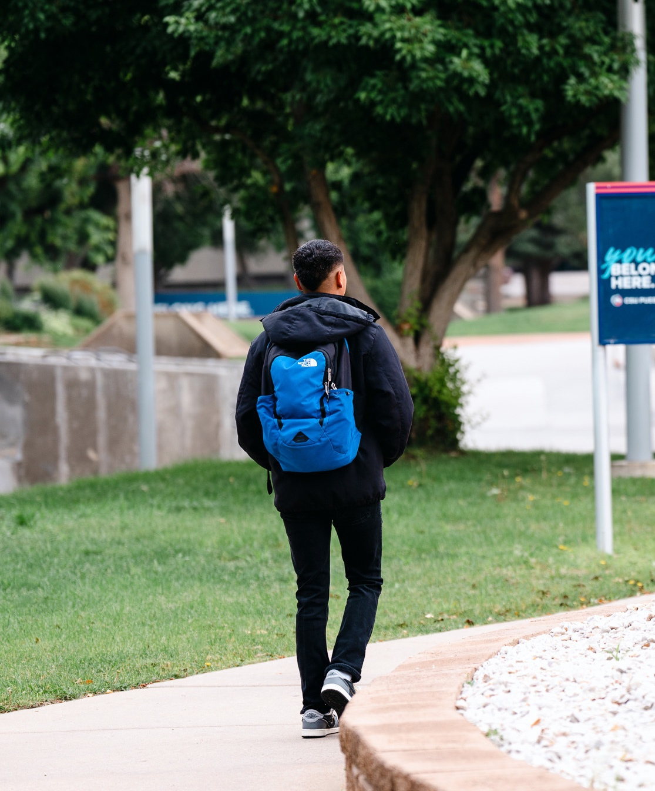


EXECUTIVE ORDER & LEGISLATIVE
TASK FORCE

Slide 2




Strategic Response for
Effective Decision Making
01
Executive Task Force Creation
02
Communication with Campus
03
Updates on Federal Actions Website
Notes:
Just returned from the HACU (Hispanic Association of Colleges and Universities) Legislative Conference and it was an important reminder of the valuable work HSI’s play in the social and economic mobility of Latino students, and that the work at CSU Pueblo in this area helps ALL students.
Rising tides, lift all boats.
President Munn asked me to take on a leadership role at Pueblo regarding the EO’s and government relations both at the state and federal level
EO I met with President Munn and suggested that it would be appropriate to gather a response team for two reasons, to engage campus stakeholders and develop plans to effectively implement appropriate changes
Created a website for information dissemination to campus

Slide 3

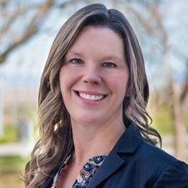
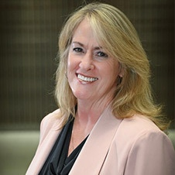
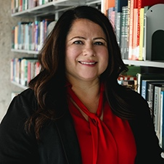
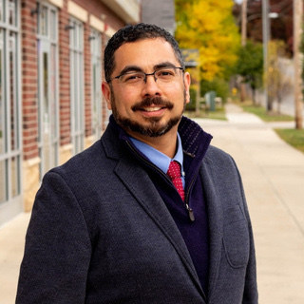
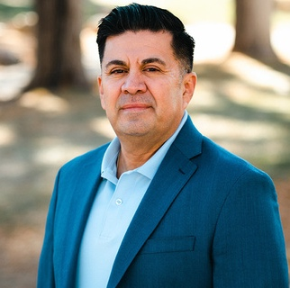
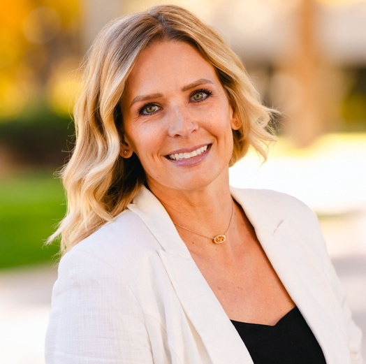
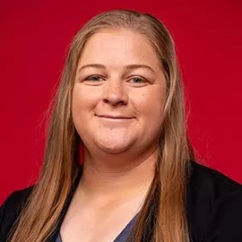
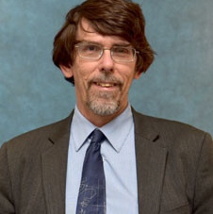
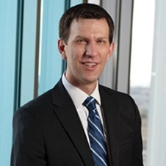
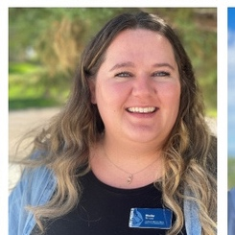


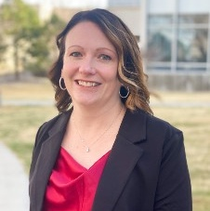
MEMBERS
Dr. Kristyn White Davis
Co-Chair
Johnna Doyle, JD
Co-Chair
Dr. Lucie Menjivar
Student Affairs
Dr. Jon Vasquez
Research & Sponsored Programs, TRiO
Christopher Beltran
HSI Funding & Initiatives
Gena Alfonso
Communications/PIO
Jenna Fall
Athletics
Dr. Rick Kreminski
Academics & Faculty
Dr. Steven Liebel
Academics & Faculty
Shelby Serena
Institutional Equity
Trisha Macias
Extended Studies
Christopher Fendrich
Office of Financial Management
Monica Hardwick
Student Financial Services
Jennifer Martin-White
Human Resources
Notes:
Created The EO Task Force with representatives from across campus
Co-Chair: Deputy General Counsel Johnna Doyle
Highlight – Dr. K and Dr. Steve Liebel

Slide 4

EO TASK FORCE
The Executive and Legislative Review Task Force brings together campus leaders to analyze federal changes and guide strategic, mission-aligned responses. Members represent key areas including legal, enrollment, finance, faculty, communications, student support, athletics, human resources, research & sponsored programs,and HSI initiatives.
ASSESS
Recommend next steps for compliance, adaptation, and strategic response.
Assess potential academic, operational, and financial impact of federal policies.
RECOMMEND
Identify specific campus departments, programs, and initiatives that may be impacted.
REVIEW
IDENTIFY
Review federal executive orders and legislation relevant to higher education.
Notes:
Due to CSU Pueblo designation as an HSI, there is a sentiment from both our President and the committee that allow us the opportunity to respond a little differently
We meet weekly to review new orders, new developments across campus, and make recommendations to Cabinet / President Munn
Title V of the Higher Education Act of 1965 is the law
An executive order cannot repeal Title V of the Higher Education Act of 1965, as amended through September 2006, in which Congress found that “Hispanic Americans are at high risk of not enrolling or graduating from institutions of higher education.”
Section 511 of Title V calls for Hispanic-serving institutions to “set forth, or describe how the institution will develop, a comprehensive development plan to strengthen the institution's academic quality and institutional management and otherwise provide for institutional self-sufficiency and growth.”
CSU Pueblo is a regional university that serves Southern Colorado
Our mission as a university is to close the educational attainment gap in Southern Colorado. We are rooted in our community and are the school of choice for our students from the rural region – we are an HSI, but also a Minority Serving Institution, and that is a key part of our service to Colorado.
Our work is important, and it is lawful.
To be in compliance with the law we must expand opportunities for Hispanic students and do everything we can to increase the attainment of Hispanic students toward a college degree. This is work that not only creates a powerful ripple effect for all of our students but is good for our communities.

Slide 5
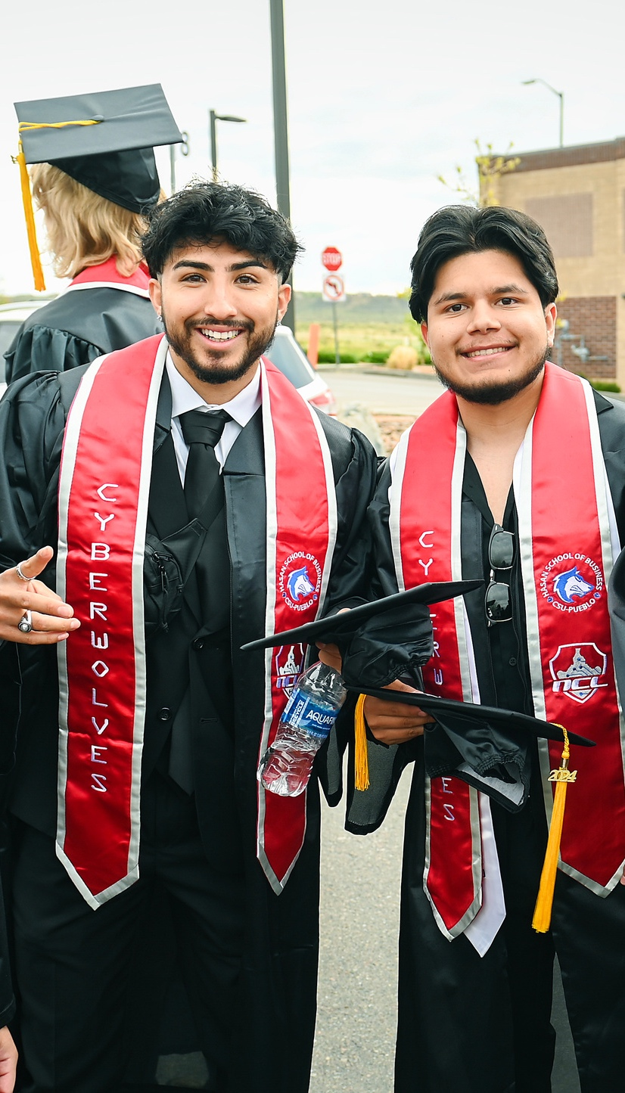
“To be in compliance with the law
we must expand opportunities for
Hispanic students and do everything we can to increase the attainment of Hispanic students toward a college degree. This is work that not only creates a powerful ripple effect for all of our students but is good for our communities.”
– Interim President, Rico Munn
HISPANIC SERVING INSTITUTION
Notes:
Lean into the HSI designation and how that mission should drive our work

Slide 6
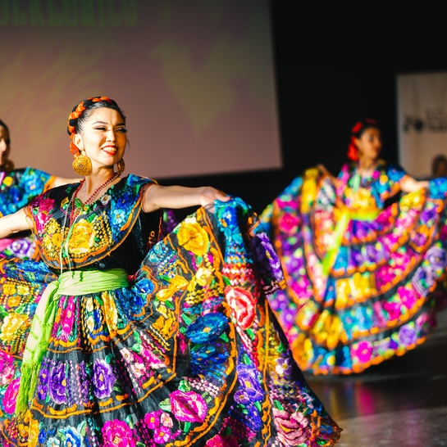


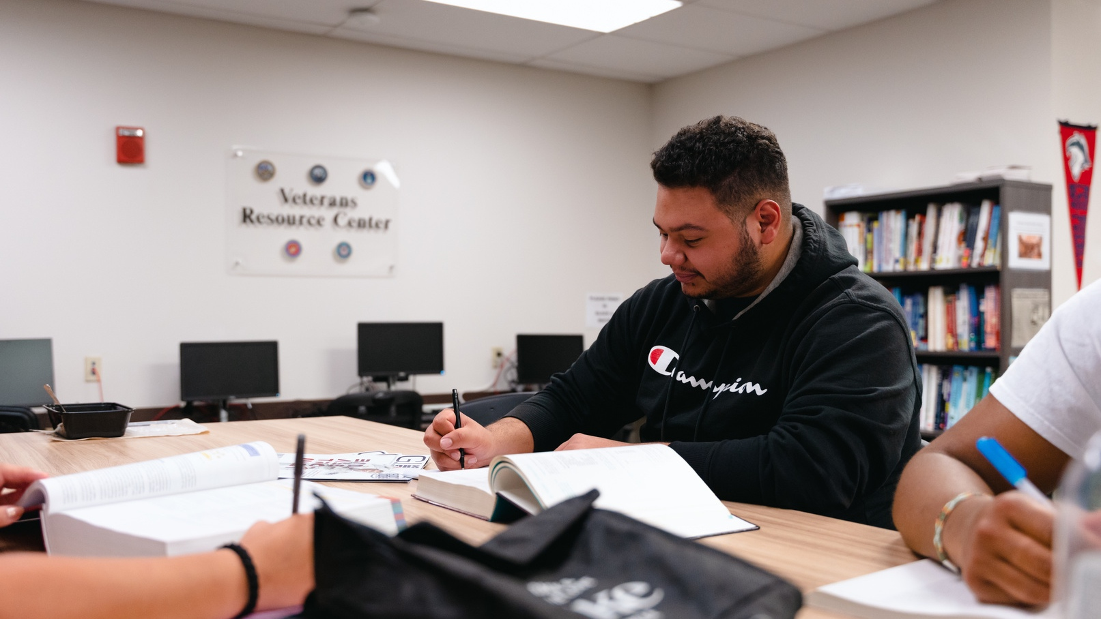
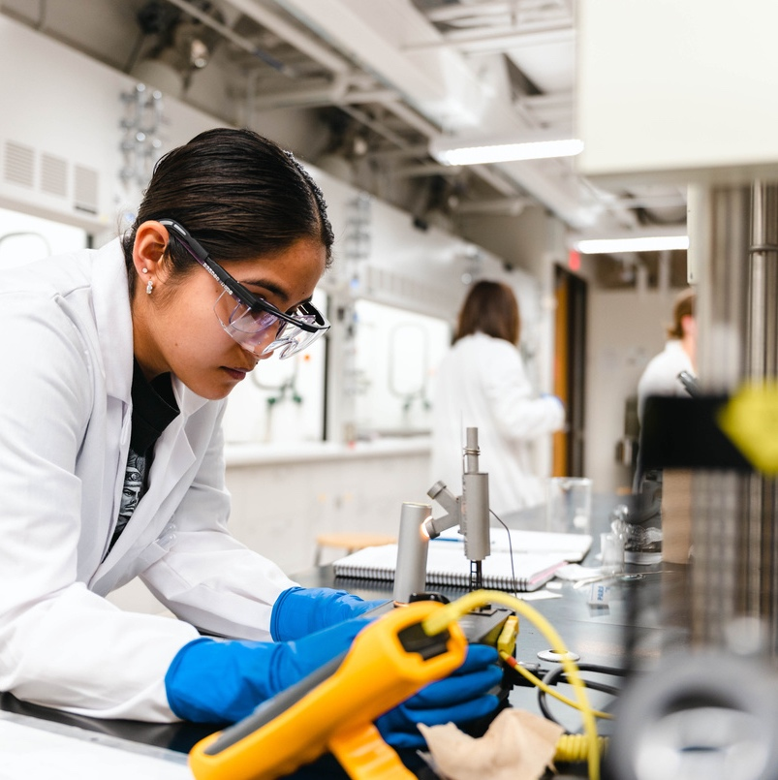
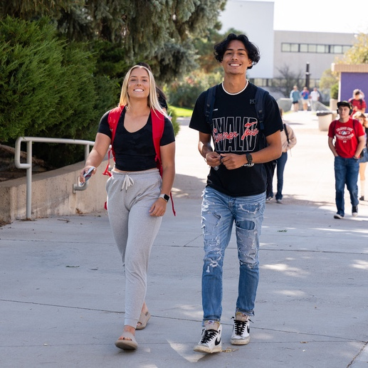
BEST PRACTICES
While CSU Pueblo has long demonstrated a commitment to the success of all students through Hispanic Serving Institution responsive practices, the Executive Order Task Force provides an opportunity to formalize, align, and elevate those efforts using a nationally validated HSI framework.
Culturally Relevant Pedagogy
Inclusive Campus Environment
Support for First-Generation College Students
Robust Student Support Services
Clear Academic and Career Pathways
Community Engagement and Partnerships
Data-Driven Decision Making
Leadership Development Opportunities
Language Access and Support
Support for Low-Income Students
Expanded on-and-off Campus Employment Opportunities
Notes:
First we reviewed all possible places across campus with the EO’s might have a direct impact or clear correlation but leaning into the HSI area which does designate the importance of Diversity, and building belonging and opportunity — we tried a different approach. Rather start cutting / eliminating DEI from campus, we presented research driven “best Practices” for HSI and with that in mind.

Slide 7




CULTURALLY RELEVANT TEACHING
Responsive Teaching
Faculty Training
Notes:
Chicano Studies Minor
Diversity Studies Certificate
We have continued to offer and not make changes to curriculum

Slide 8
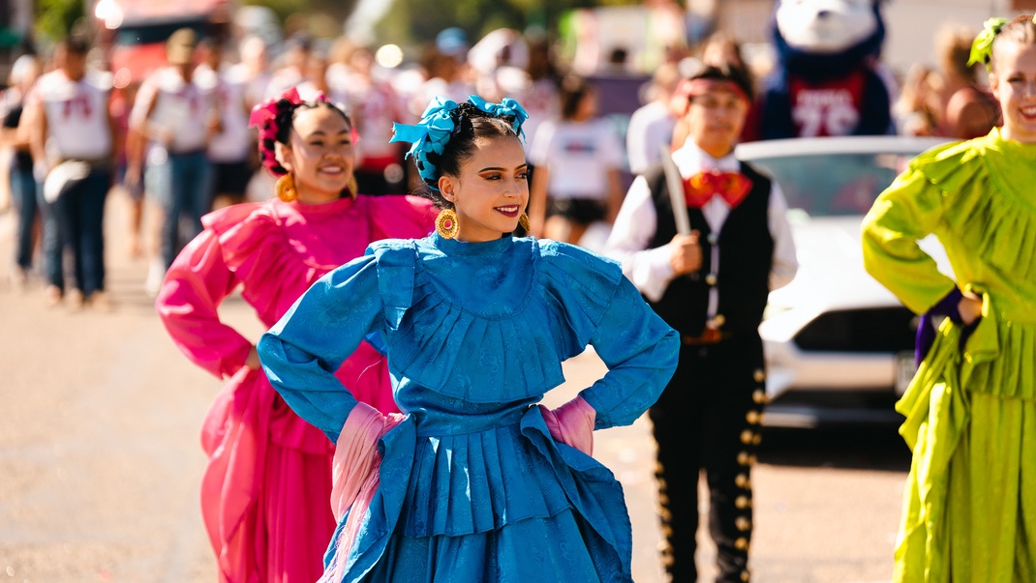
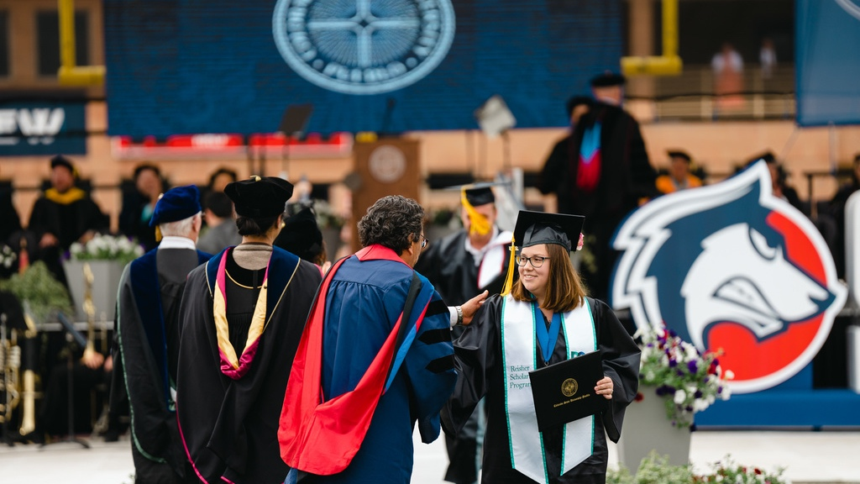
CREATING AN INCLUSIVE CAMPUS CLIMATE
Celebrate Hispanic Heritage
Diversity in Leadership
and Faculty
Notes:
Continuing to offer student engagement activities that celebrate different cultures. We don’t have any designated “Cultural Spaces” but rather our affinity spaces are Student Organizations. However, we received validation that these student groups in bot mission and practice are open to all students. For example: a white student would be welcome to participate In events and activities of the Black Student Union.
Knowing this – the committee discussed the importance of allowing students to highlight their affinity groups at through graduation and regalia. Cabinet and President Munn were supportive and the message was shared with graduating students.
Ballet Folklorico performs at many campus events, including Discover Day and is highlighted as one of the gems of CSU Pueblo

Slide 9

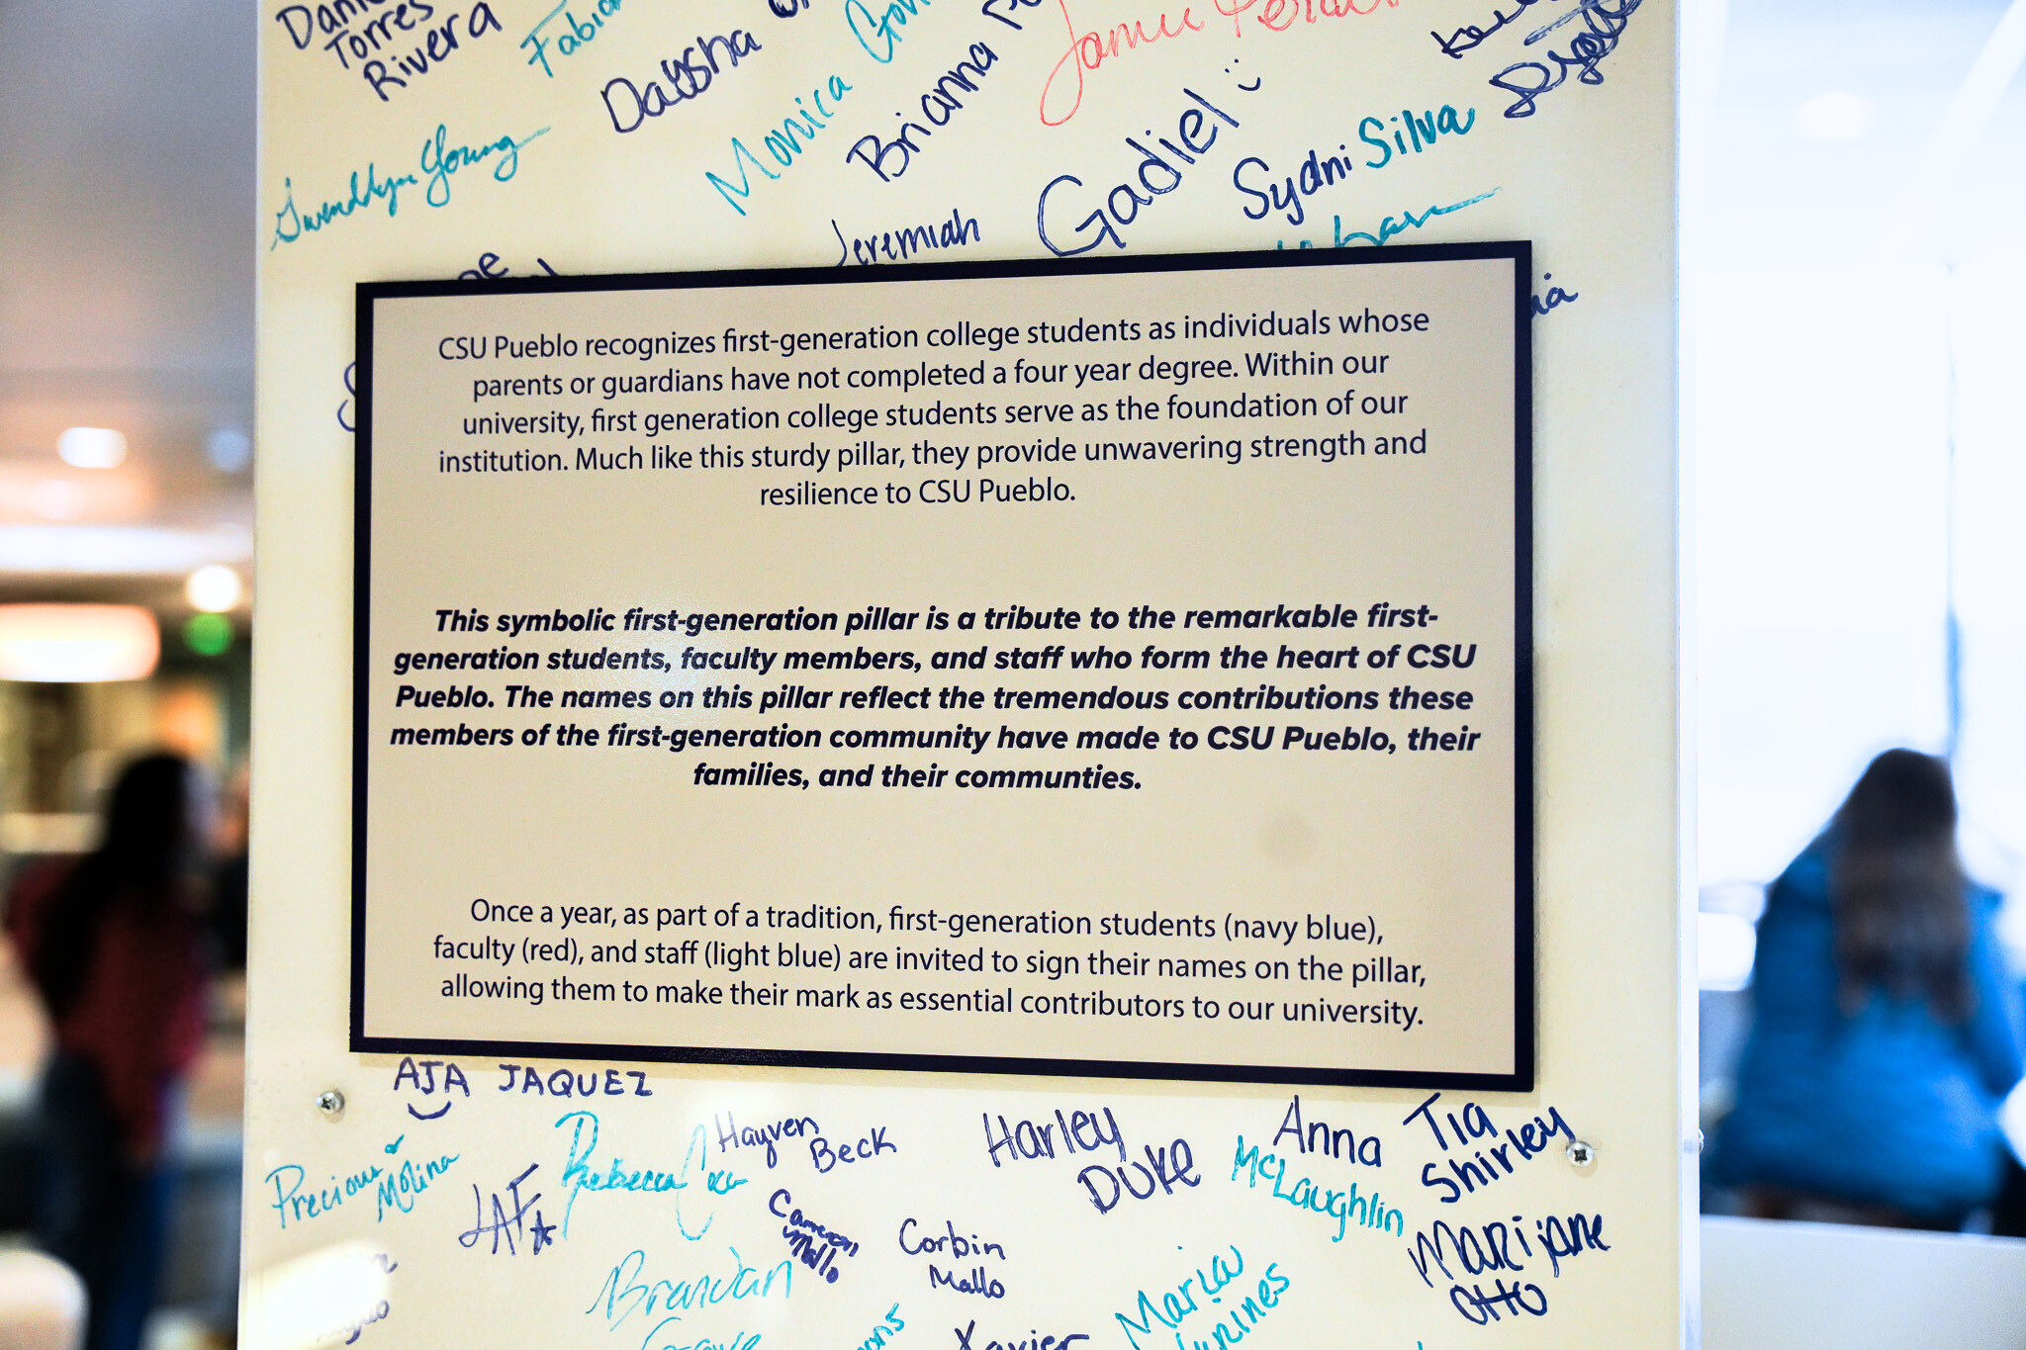
SUPPORT FOR FIRST-GENERATION STUDENTS
Living-Learning Community
First-Generation Student Pillar and Celebration
First-Generation Student recognition
at Commencement
Notes:
Last year we implemented the First Generation signing day and we have had a day where first generation students can leave the mark on the university. We show this wall during tours now and I think it does 2 things: 1) it highlights and celebrates our first gen students and 2) reminds them they are not alone

Slide 10
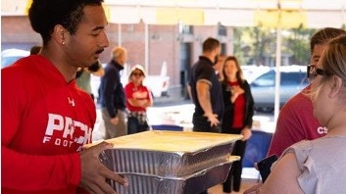

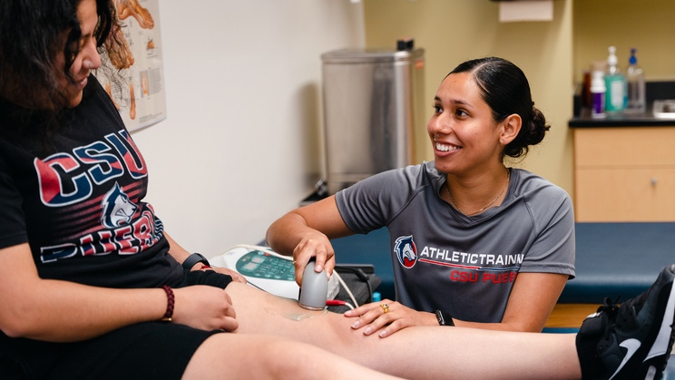
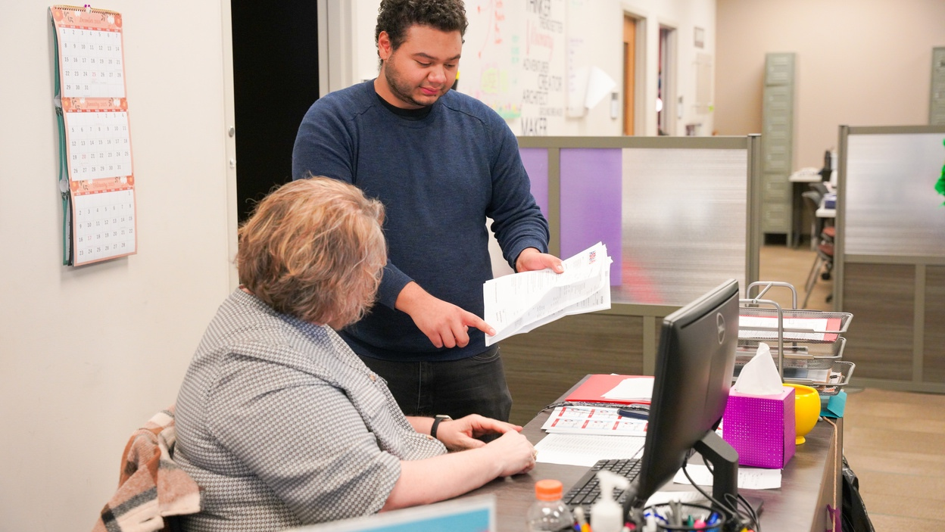
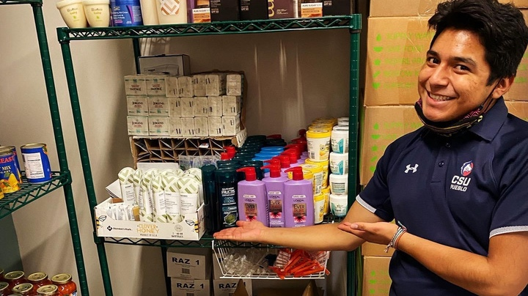
STRONG STUDENT SUPPORT
Creating pathways
Pack Center
Student Center for Advocacy and Support
Pack Pantry
Pack Counseling Center
Tutoring Centers in Multiple Disciplines
Financial Support
Career Center
Pack CARES
Notes:
Counseling, tutoring, intrusive advising, the Career Center and more all designed to help our students succeed - Many of these services are supported by Title V funds that ALL students benefit from. We are working on messaging that continues to highlight that these services are available for students.

Slide 11
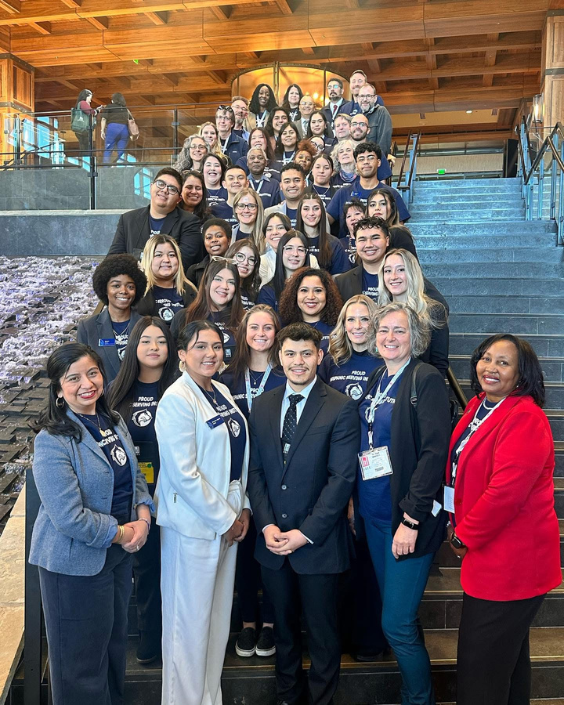
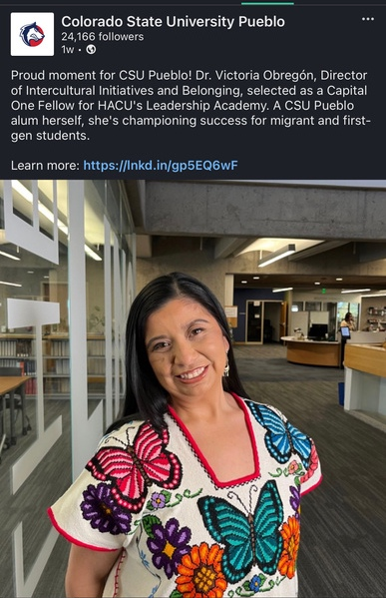
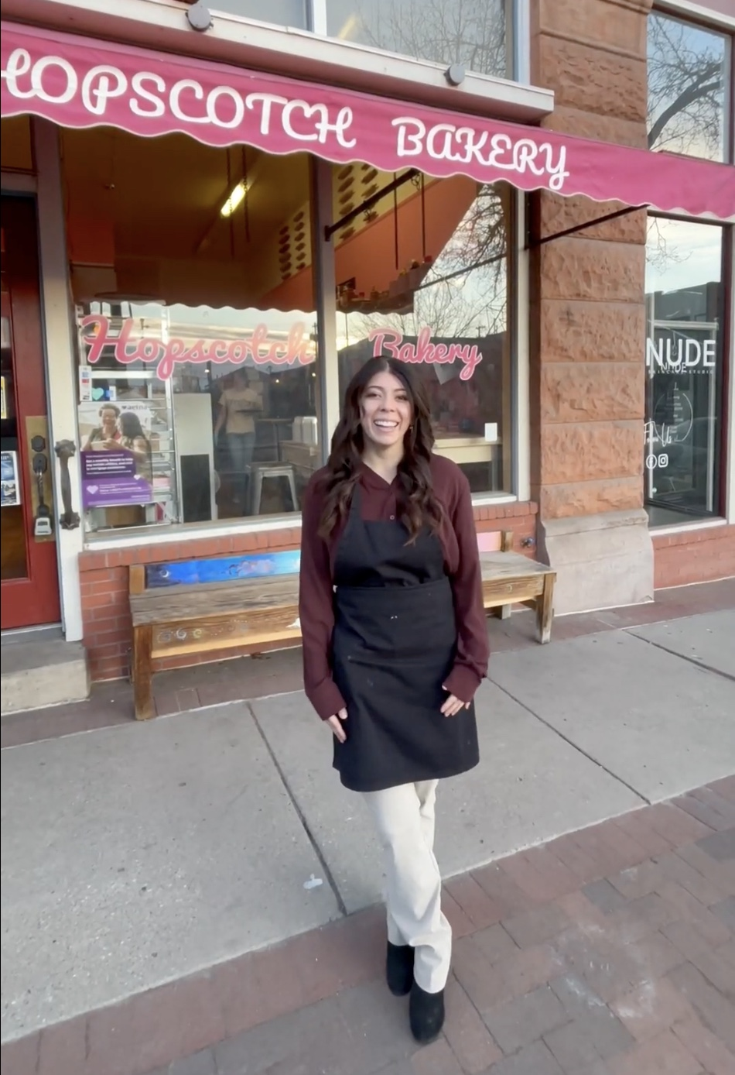
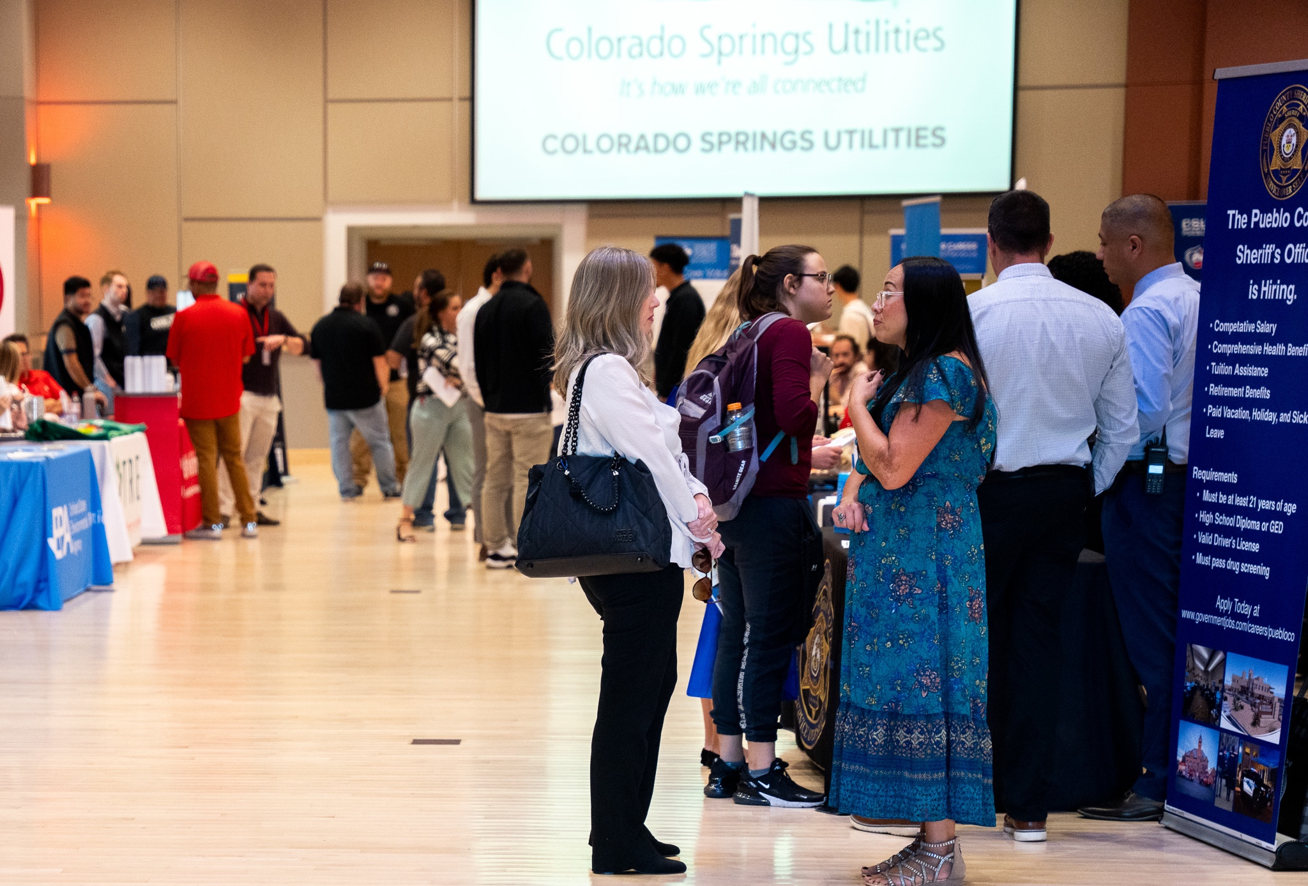
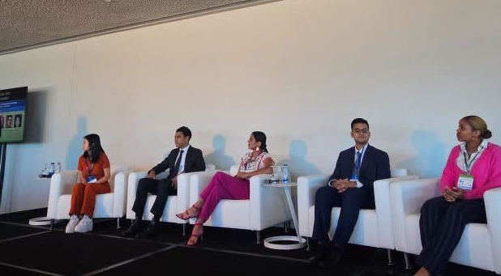
CREATING PARTNERSHIPS AND ENGAGEMENT
Promoting Leadership Opportunities
HACU LEADERSHIP OPPORTUNITIES
GLOBAL MINDED
CAREER & INTERNSHIP FAIRS
ON-CAMPUS LEADERSHIP ROLES
Notes:
HACU – we took over 20 students to HACU in Denver this year using title V funds
Alondra speaking at the Global Minded First Gen Presentation at the UN in New York
Career and Internships, Mentor Match
Undergraduate Research – Discovery Scholars

Slide 12



DATA-DRIVEN DECISION MAKING
37%
50%
83%
identify as Hispanic
self identify as belonging to an
underrepresented group
receive financial aid or scholarships
Notes:
Making sure that as we make decisions as a campus we are doing with data, which is vastly better since moving to Banner and the technological resources. Both Enrollment and AA have invested in data staff to help make strategic decisions.

Slide 13

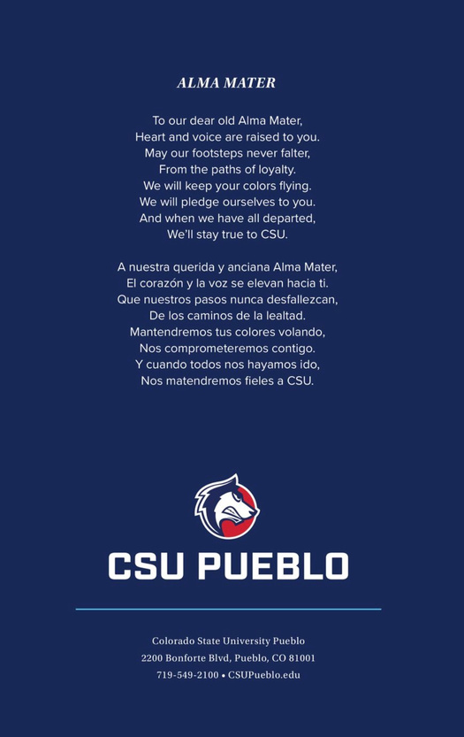
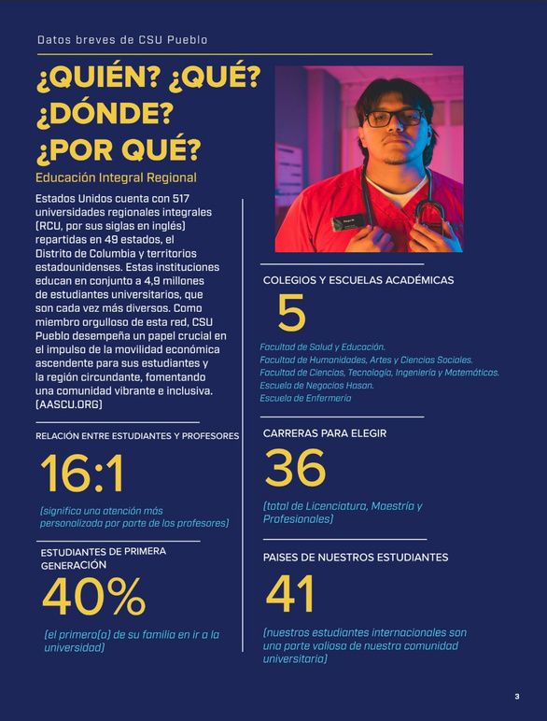
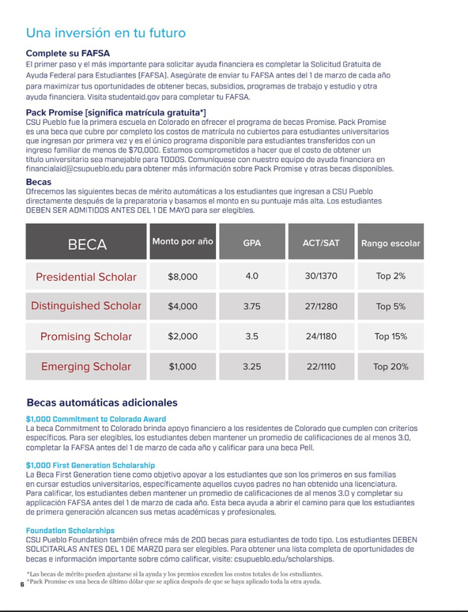
“If you talk to a man in a language he understands, that goes to his head. If you talk to him in his own language,
that goes to his heart.”
–Nelson Mandela
LANGUAGE SUPPORT
Commencement Translation
and Interpretation
Spanish Viewbook
Notes:
We offer our Viewbook and many other materials in Spanish to facilitate the family going culture that is needed for many Latino first generation students. We are working to enhance our bilingual staff in many offices to support students and utilize certified interpreters for events such as Commencement.

Slide 14
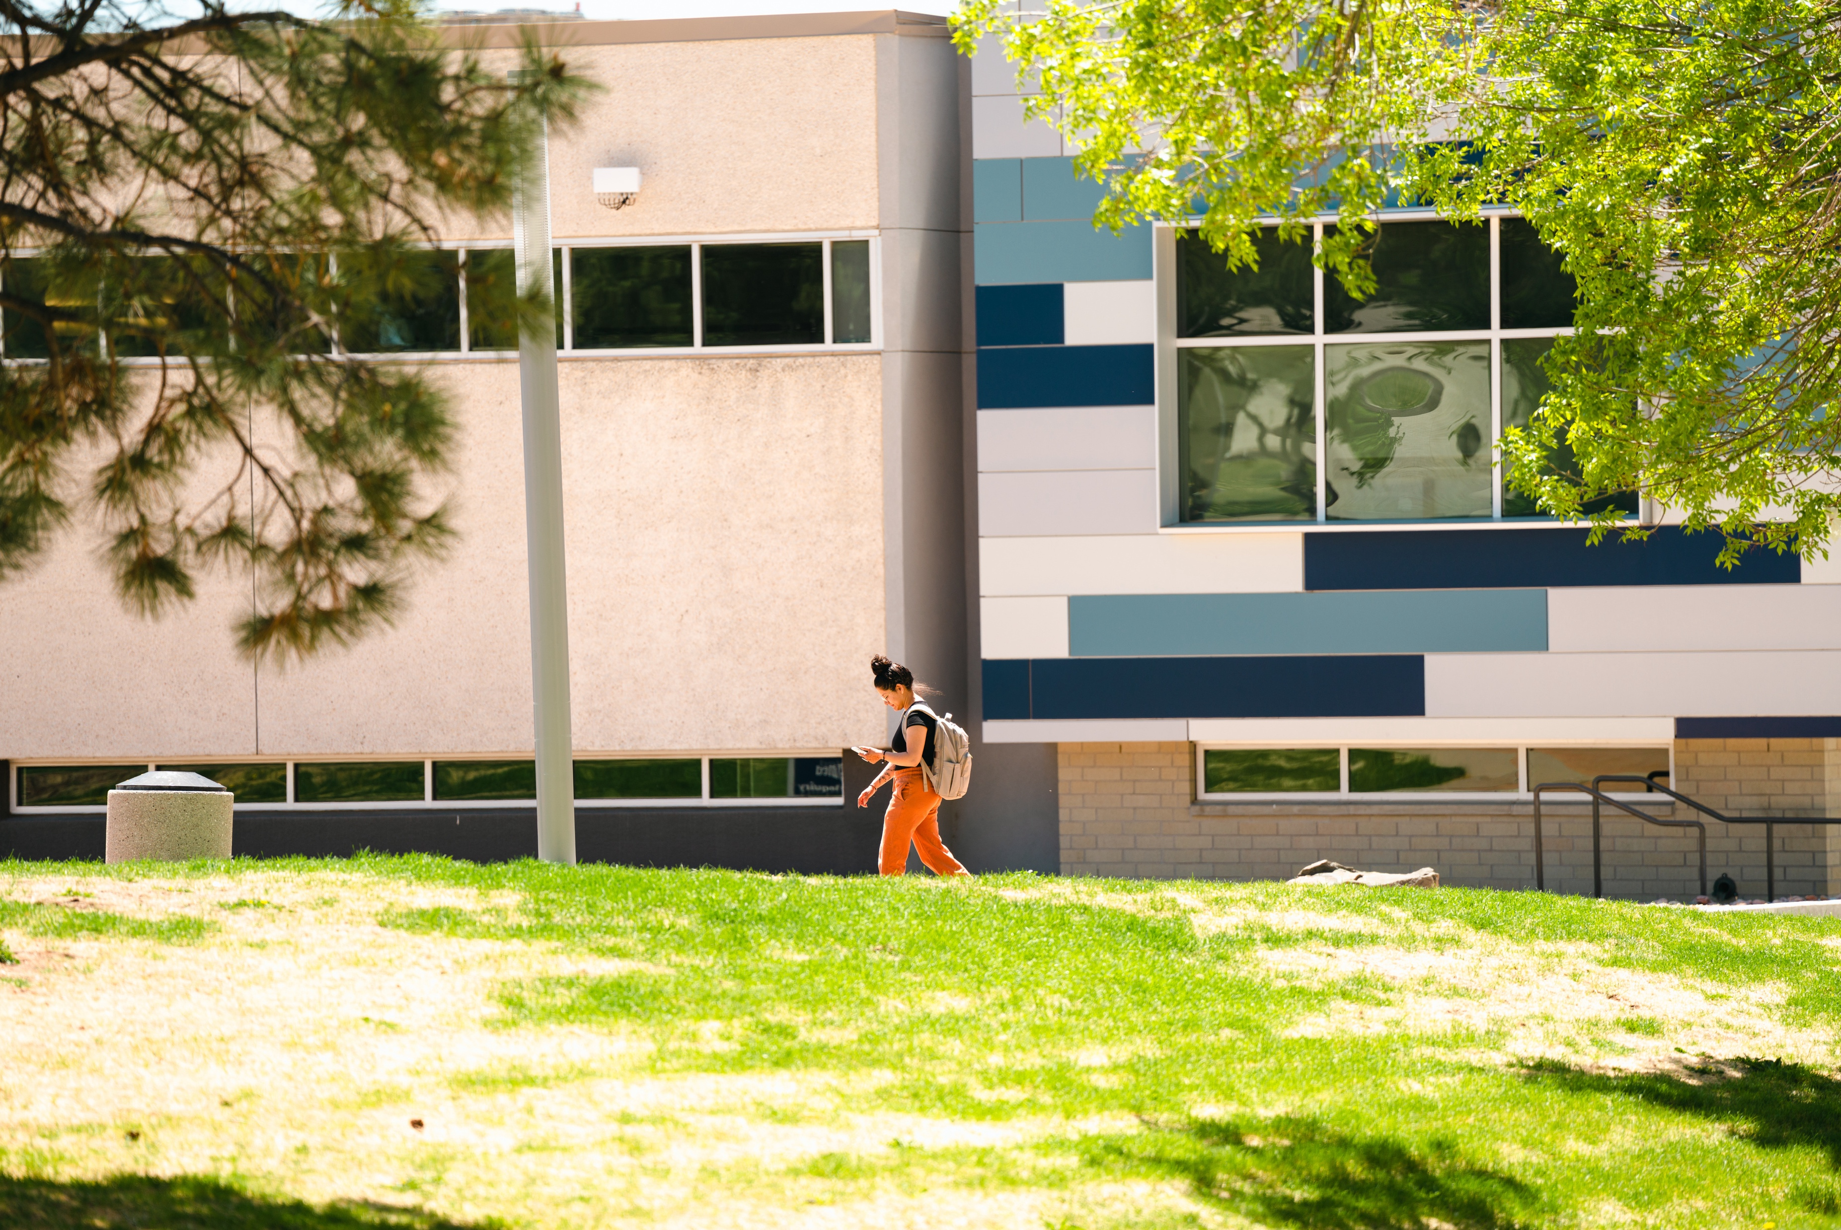







FRAMEWORK FOR FUTURE SUSTAINABILITY
Inclusive Campus Climate
Academic and
Career Pathways
Promoting Leadership Opportunities
Culturally Relevant Pedagogy
Strong Student
Support Services
Data-Driven
Decision Making
Language Support
Notes:
These BEST Practices were presented to the task Force and we agreed that using this framework would guide future decision making. Knowing there are uncertainties that lie ahead, we feel confident that these best practices guiding our decision making will give us an opportunity increase access and opportunity of all students. And due to the EO’s other changes neccesate some shifts, but those will be done with this framework and will help guide future decision work and it is worth mentioning that highlighting this framework has for decisions has been going on for many years, and validated by our receiving several Title V grants.
Now we are just formalizing what we were already doing as part of a strategic Cabinet effort for deciding in multiple areas across campus including the budget. The mission should drive our work and subsequently the decisions we are making

Slide 15
RESOURCES
Valdés (2001): Emphasized the importance of bilingual education and language support for bilingual students.
Moss & Puma (1995): Found that effective language support programs improve academic achievement.
August & Shanahan (2006): Highlighted the role of language support in promoting literacy and academic success
Baker (2010): Highlighted the role of community partnerships in strengthening student engagement and success.
Kezar & Rhoads (2001): Emphasized the mutual benefits of academic-community partnerships.
Perry (2008): Discussed how community partnerships enhance educational outcomes.
Tinto (2006): Emphasized the importance of using data to improve student retention. Wayne (2009): Highlighted the role of data in identifying trends and improving student success. Marsh et al. (2013): Discussed the impact of data analytics on student learning and institutional performance.
Karp, Hughes & O'Gara (2010): Found that clear academic pathways improve student retention and success. Destin & Soria (2019): Highlighted the importance of connecting academic programs with career prospects for first-generation students. Hughes & Karp (2006): Emphasized the role of career pathways in improving student retention. Bean & Eaton (2000): Highlighted the importance of support services in helping students navigate academic and social challenges. Braxton et al. (2000): Found that institutions with strong support services have higher retention and graduation rates.
Hurtado & Carter (1997): Found that an inclusive campus climate significantly contributes to students' social integration and academic achievement.
Museus (2014): Developed the Culturally Engaging Campus Environments (CECE) model, emphasizing the importance of engaging students' cultural identities.
Rankin & Reason (2005): Highlighted the positive impact of an inclusive campus climate on student satisfaction and retention.
Gloria Ladson-Billings (1994): Introduced the concept of CRP, emphasizing the importance of reflecting students' cultural experiences in teaching.
Geneva Gay (2010): Highlighted the effectiveness of culturally responsive teaching in improving outcomes for ethnically diverse students.
Banks et al. (2005): Discussed the need for inclusive curricula that acknowledge diverse cultures and histories.
Notes:
Thank you for the opportunity to share this work with oyu and I am grateful that Interim President Munn has asked me to lead such important work on our campus and the opportunity to talk with you all today.

