Slide 1

counseling center opportunities for staff
APC MEETING, February 10, 2021
Joanne “Joe” Smiley, RN, MSN, ANP, GNP-bc, PMHNP-bc

Slide 2
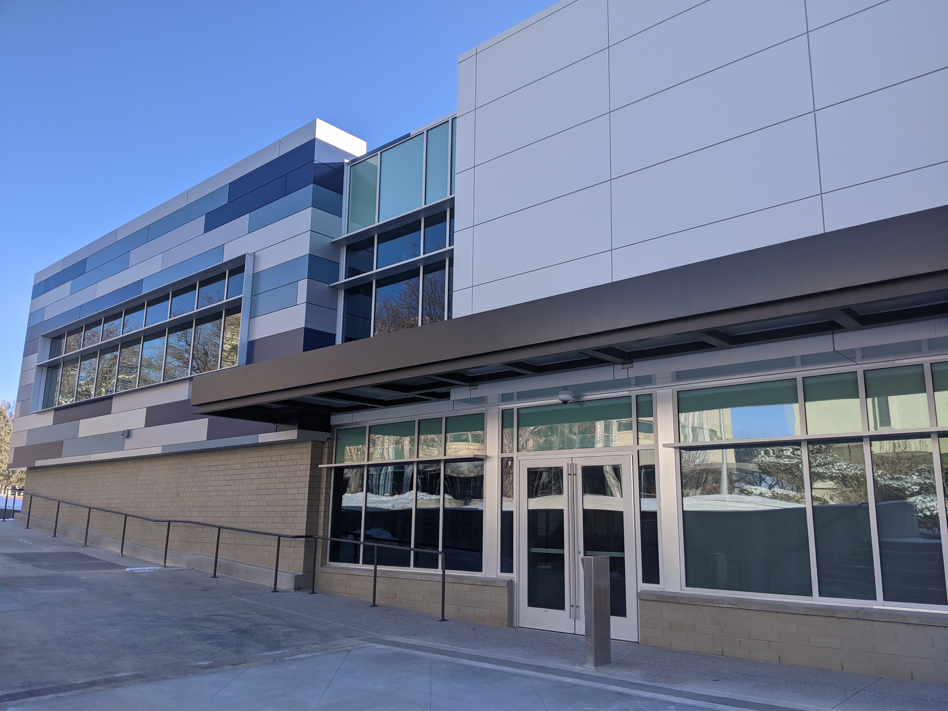
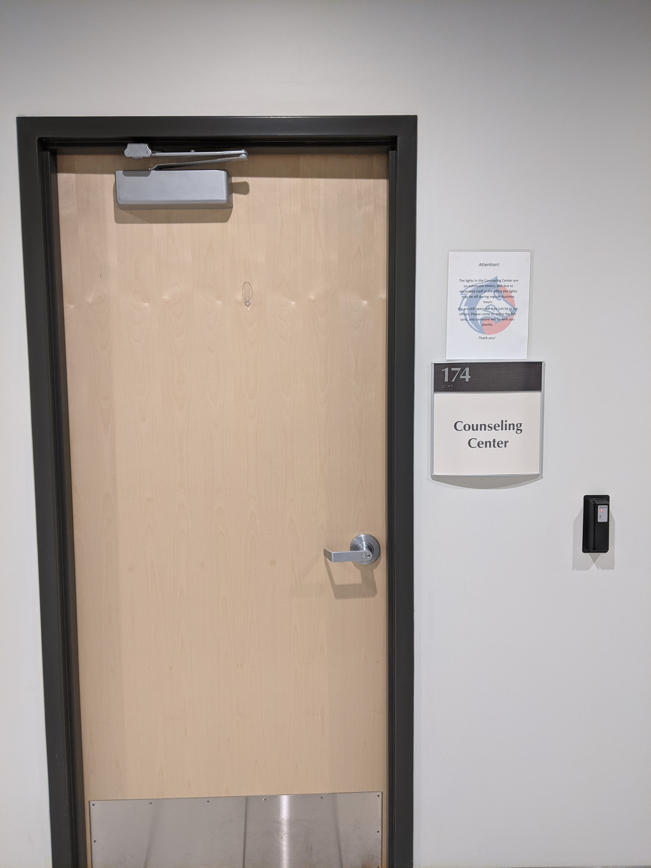
We are located
In the Center for Integrated Health and Human Inquiry (CIHHI) building, Room 174

Slide 3

Hours of operation
Monday through Friday
8:00 am to 5:00pm
Or as the University sets the times
Currently at 10% (like everyone else)
Someone is in the office every day
Phone is forwarded and covered 24 hours a day

Slide 4
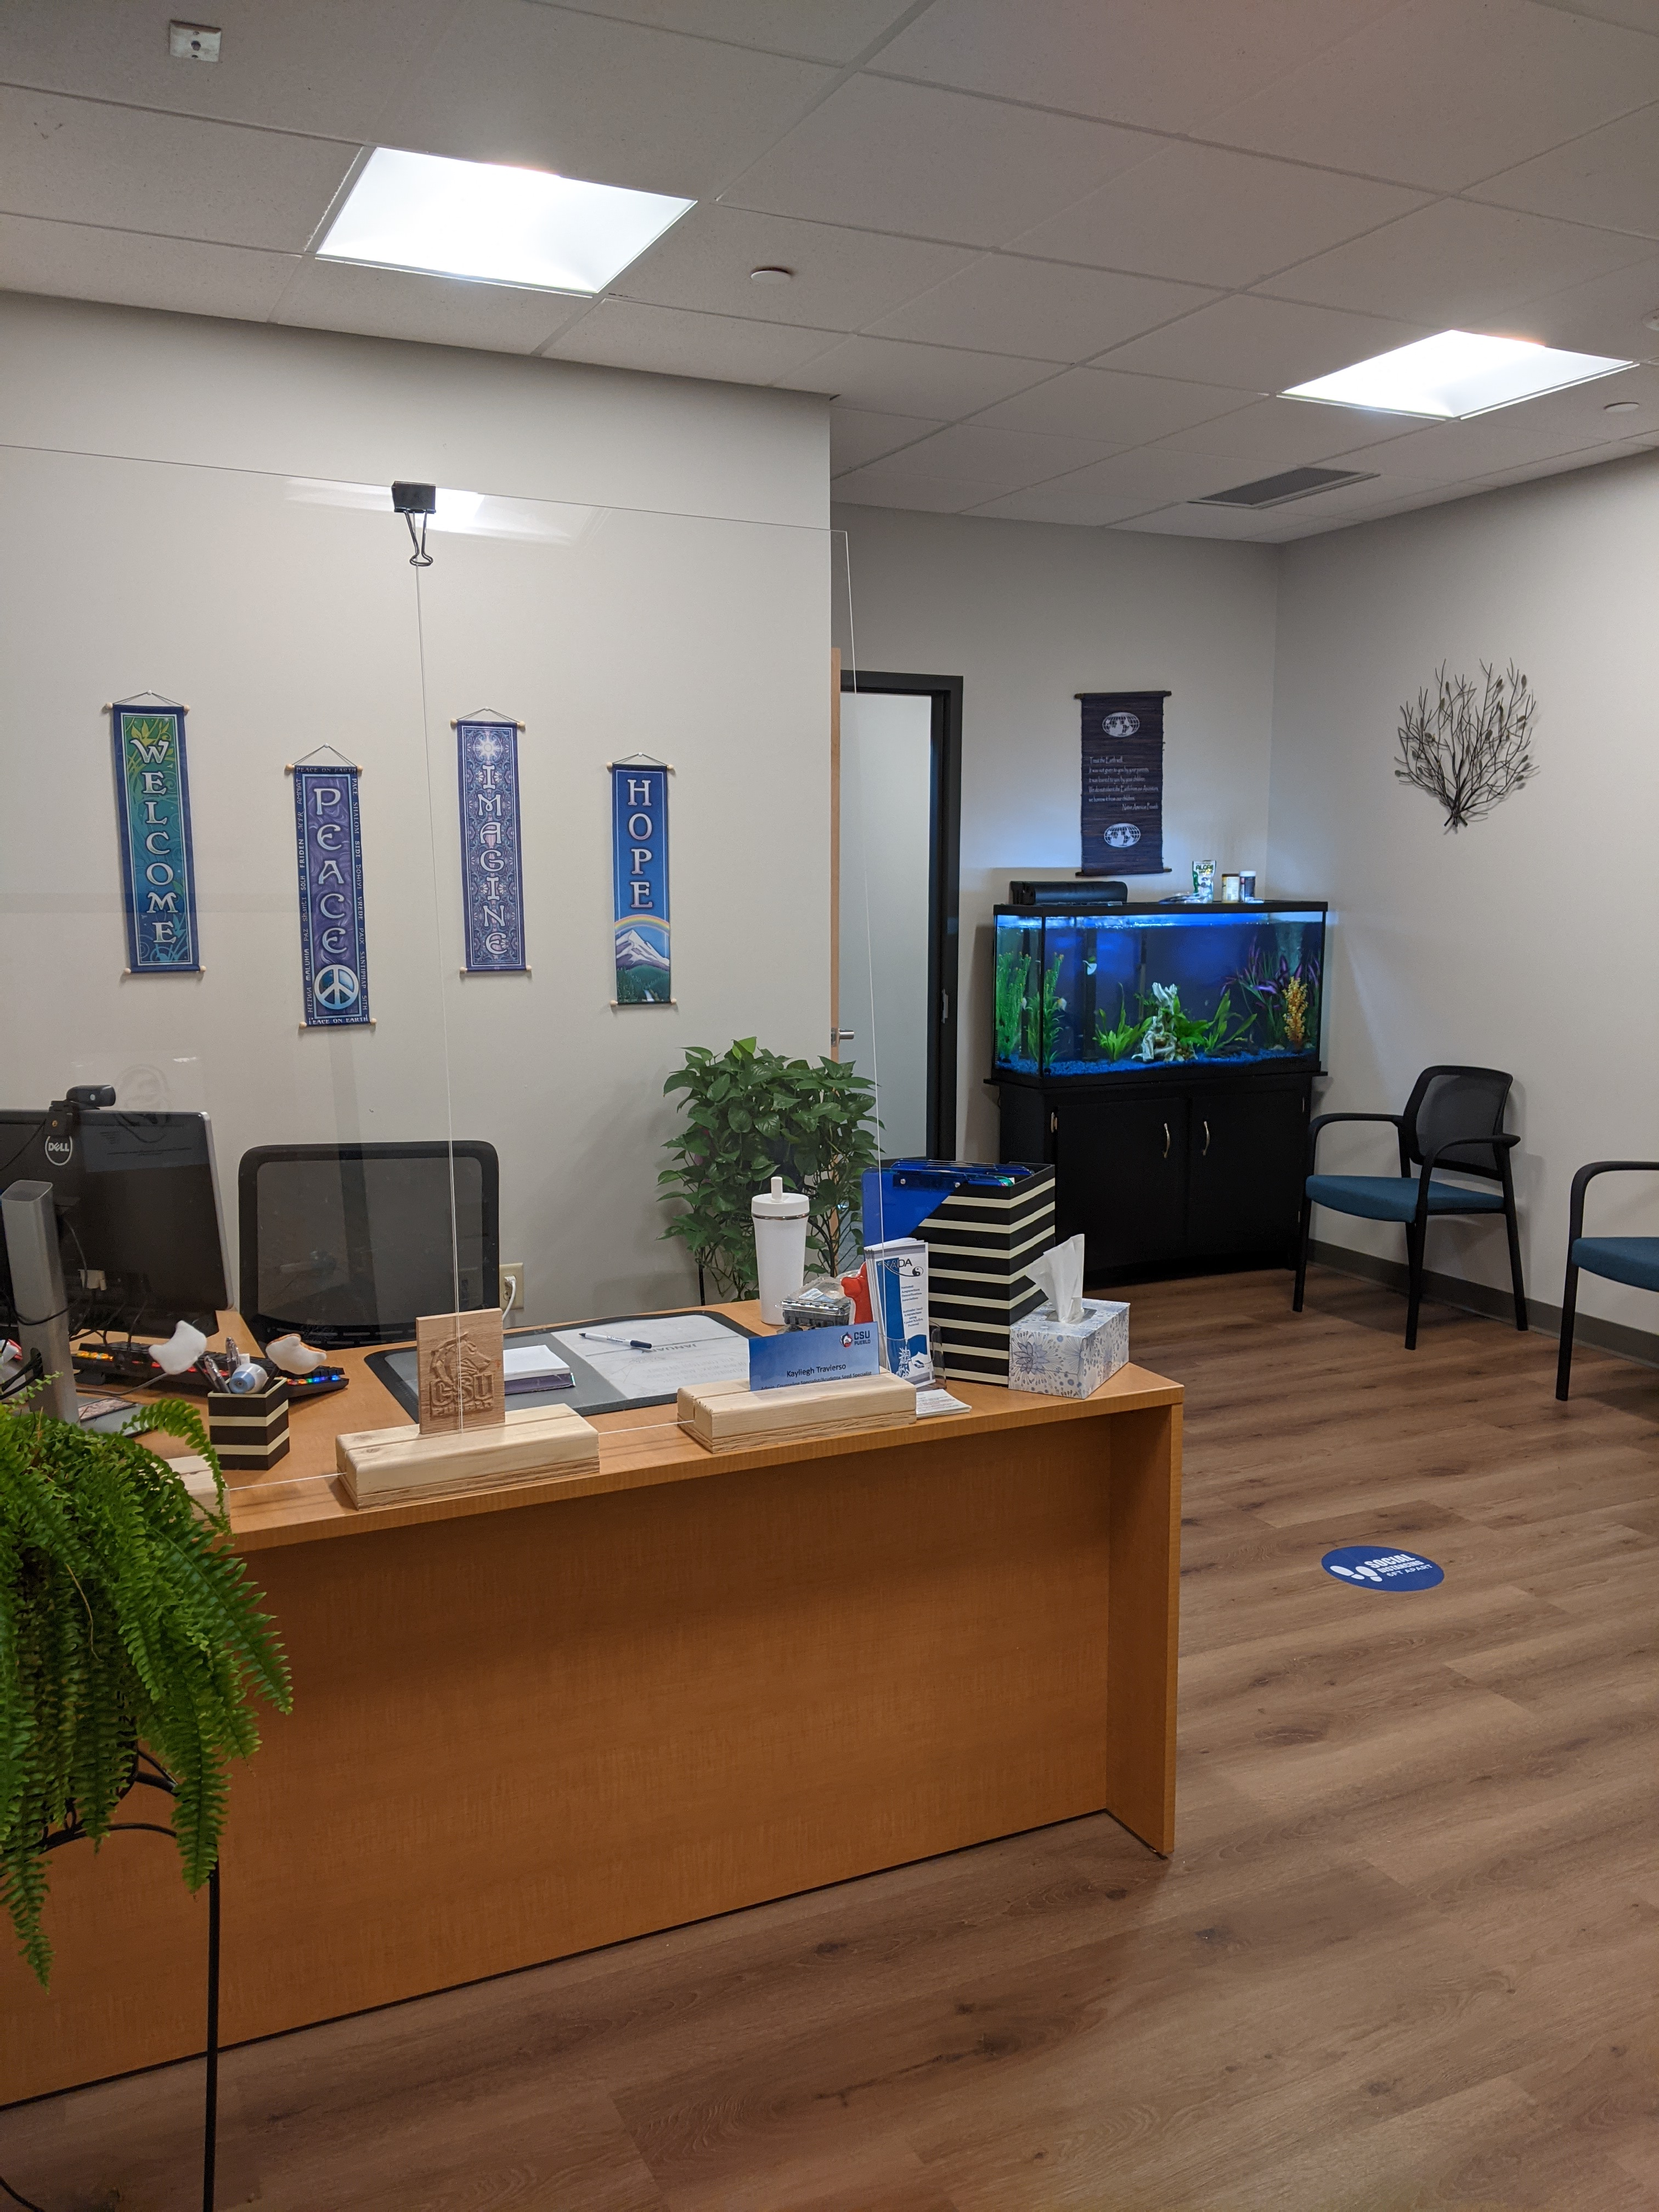
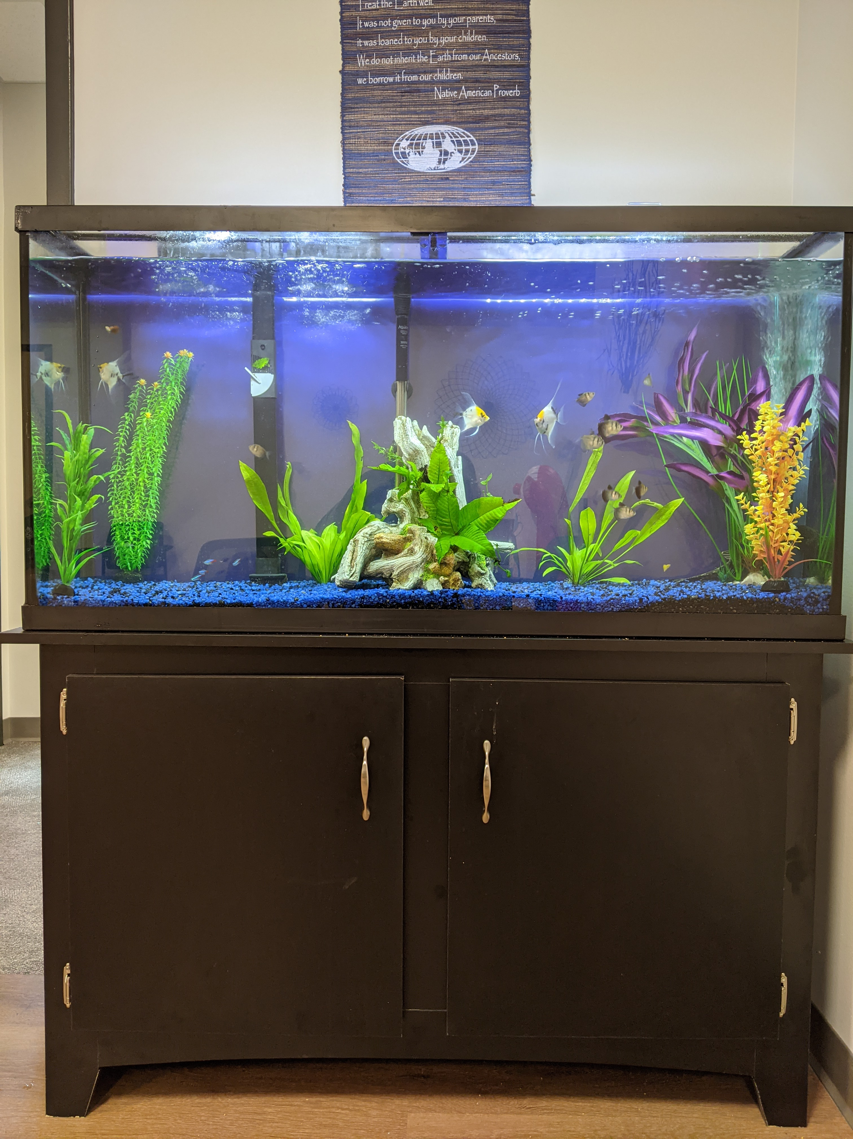
What we look like

Slide 5
Youtube video on mental health
https://www.youtube.com/watch?v=6YbWRqsnHdo

Slide 6


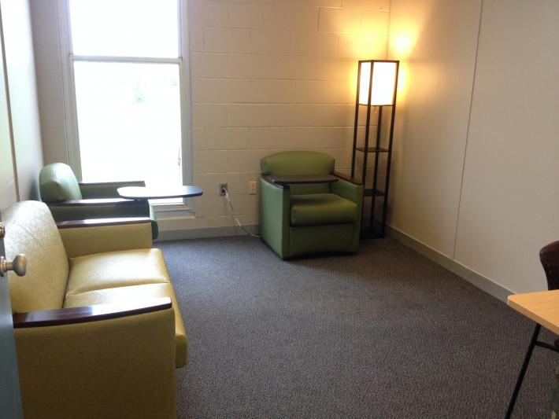
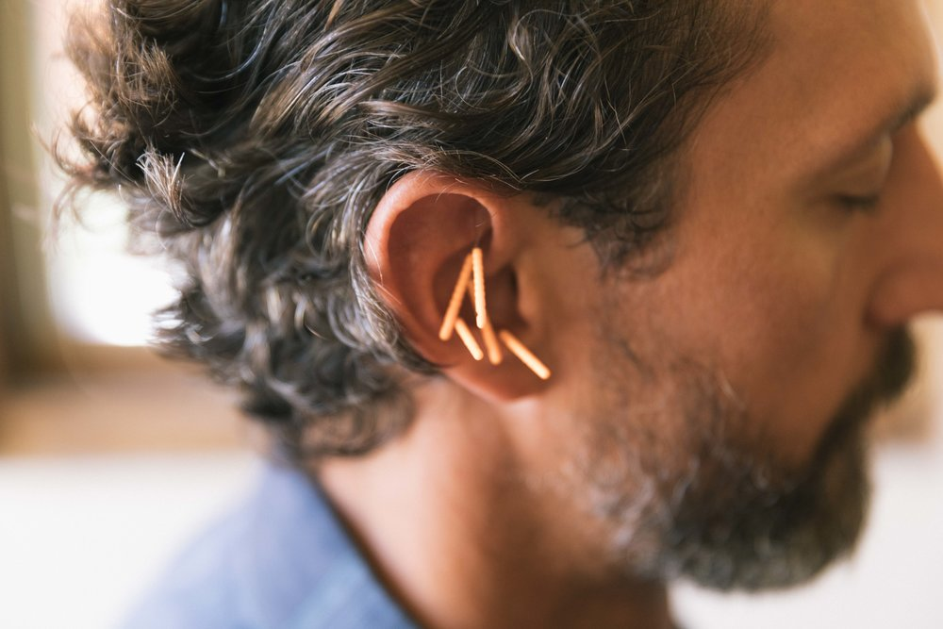






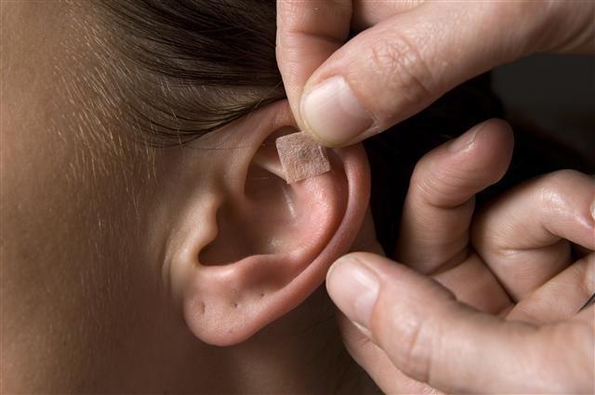
Services Provided

Slide 7

Faculty/staff services provided
Started November 11, 2020
FREE, unlimited 1:1 confidential counseling via zoom or in person
FREE, unlimited Acudetox
Dedicating Tuesday and Thursday to staff, but will adjust as needed
Laughter Yoga on Wednesday 12-1 by Kimberly Dillon via ZOOM: https://csupueblo.zoom.us/j/96573314138
Video presentations: Burnout completed and now being “refined and edited”
  Others in process of being done (Mindfulness, Meditation, Relaxation Breathing, Healthy Eating)
Working on “blast” messages to be sent out at set times of day
  “time to hydrate”, “time to step away from computer and stretch”, etc
Massage Therapy!!!!!

Slide 8

What benefit applies to needed time off
Sick Leave
Accruals
Classified
Admin Pro and Faculty
Request
Employee Portal

Slide 9

What benefit applies to needed time off
FMLA has different aspects to it and it is different based off of Classified employees or Non-Classified employees. The best thing for them to do is to reach out to me and I can help them with the process. Each instance is a little different (based off the needs of the individual) so sadly there is no blanket statement to walk employees through this process. Obviously, there are certain standards to keep to take place such as (1) The employee needs to be active for 12 months before FMLA goes active for them. (2) Once approved the employee has 12 weeks of job saving time to take for the cause of the absence.
Everything is confidential and they needs to stay in communication with their supervisors and myself during the time off.
kristin.rodriguez@csupueblo.edu (Benefit Specialist)

Slide 10
