Slide 1

APC Compensation Study: Methodology, Key Findings and Recommendations
APC Presentation
Wednesday, May 12th 2021

Slide 2
Goal of Compensation Study, Charge of APC Compensation Committee
01
WIG 3: Increase Employee Satisfaction

Slide 3
1 Goal of Compensation Study, Charge of APC Compensation Committee
Goal of APC Compensation Study: To create a process for and conduct a thorough analysis of Administrative Professional (AP) employee compensation.
Charge of Compensation Committee: The Administrative Professional Compensation Committee shall be made up of six members recommended by the Administrative Professional Council (APC) Executive Committee and confirmed by the President. The Administrative Professional Council Executive Committee will make appropriate efforts to ensure that committee members include a broad representation of the Administrative Professional staff on campus including reporting lines, funding sources, and levels of responsibility. Administrative Professional Compensation Committee members shall meet the general requirements for APC representatives based on the APC Constitution and Bylaws including time in service at the University. Members shall be recommended and confirmed annually and are not term limited.

Slide 4
Meet the Team: APC Compensation Committee
02
WIG 3: Increase Employee Satisfaction

Slide 5
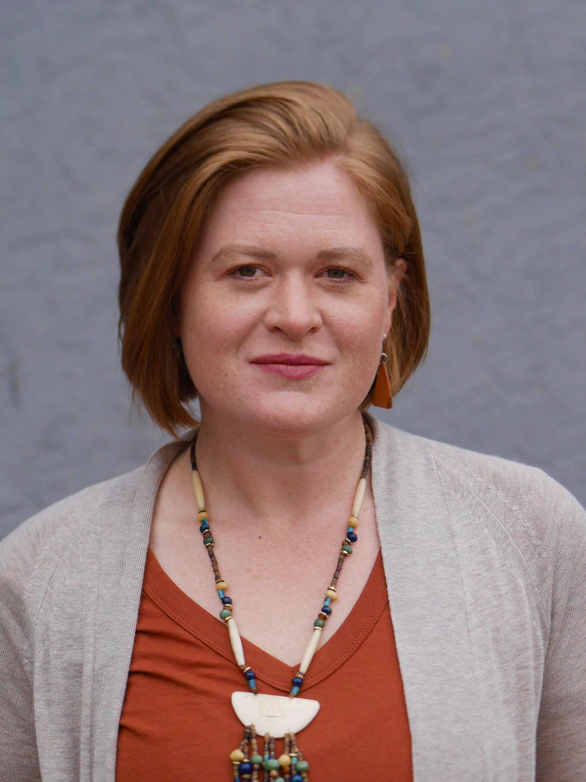
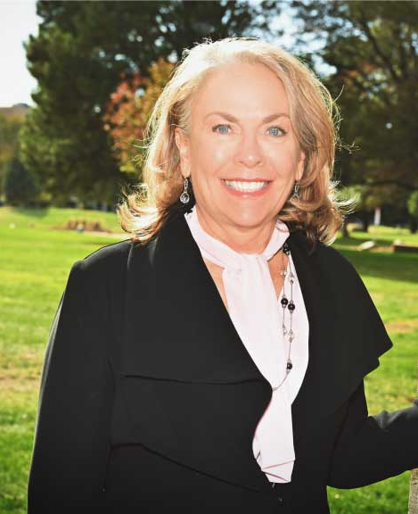


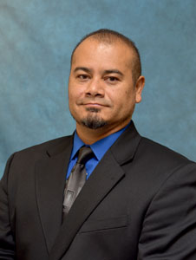

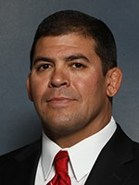

2 Meet the Team: APC Compensation Committee

Slide 6
Committee Timeline and Key Tasks
03
WIG 3: Increase Employee Satisfaction

Slide 7

3 Committee Timeline and Key Tasks
Fall 2019
Committee re-assembled and confirmed by President Mottet. Planning meetings and initial roadmap.
Spring 2020
Committee reviews all AP positions (above 0.5 FTE). Each committee member reviews over 50 positions.
Fall 2020
After a COVID pause, committee again commences work. Brings in Corey Shilling to assist. Roadmap for project developed.
Fall 2021 and Beyond
Committee meets on a monthly basis to maintain currency of compensation study and review individual compensation study requests and contentions.
Summer 2021
Preparation of final documents needed by President Mottet vetted by Legal Counsel and included for August BOG meeting.
Spring 2021
Corey expands compensation study workbook, and committee finalizes study on April 1. Results and recommendations provided to key stakeholders, with individual compensation study reports prepared and sent by end of May.

Slide 8
Compensation Study Operational Definitions and Methodology
04
WIG 3: Increase Employee Satisfaction

Slide 9
4 Compensation Study Operational Definitions
CUPA Code: Abbreviation for “College and University Professional Association”. Our main source of market wage data. CUPA conducts an annual survey of colleges across the country and CSU-Pueblo purchases these surveys to use in its evaluation of market review of positions.
SOC Code: Abbreviation for Standard Occupational Classification codes developed by the U.S. Bureau of Labor Statistics. SOC codes were used as a supplemental data point to verify CUPA code placement.
Cost of Living Adjustment: Salaries vary widely from city to city, depending on cost of living, scarcity of talent and other factors. National salaries must be increased or decreased by a location factor to regionalize salaries. According to the Robert Half 2021 Salary Guide, the location factors are: Pueblo -15%, Colorado Springs 0% and Denver is +11%. CSU Pueblo talent is mainly from Pueblo and some from Colorado Springs, therefore a blended rate of -6% was used to regionalize salaries at the University.

Slide 10
4 Compensation Study Operational Definitions
Gender Equity: Women and men are paid the same for performing work requiring similar skill, effort and responsibility.
Compensation Data: Obtained from the CUPA-HR Annual Reports for Staff, Professionals, and Administrators, using the Table 2, Master’s salary for each CUPA code.
For staff determined to have a job consisting of multiple distinct CUPA job duties, a weighted salary was determined which could consist of up to seven job duties.
Table 2 Master’s salary was then converted into a range by subtracting or adding 13% to this lookup value for the lower and upper bounds, respectively.
Compa-Ratio: An individual’s pay rate is divided by the midpoint of a predetermined salary that was identified from the CUPA-HR Annual Reports.
A 1.0 compa-ratio indicates that employee pay is at the exact midpoint of the range, whereas values higher or lower than 1.0 indicate how far over or under they are paid relative to the midpoint.

Slide 11
4 Compensation Study Operational Definitions
Pay Range: Boundary for compensation with a minimum of 25%, midpoint of 50% and maximum of 75%
The CUPA value, adjusted for location, is considered mid-point, with the minimum and maximum values calculated using a 13% differential
Consistent with entry to mid-level professional and management positions using methodology by Milkovich and Newman, leading authorities in the field of Compensation
Market Compensation Analysis: The full name of the present study
Analysis = what was done
Compensation = what was analyzed
Market Data = how it was analyzed

Slide 12
4 Compensation Study Methodology
Original compensation study workbook developed by Kat Abernathy (with support from Josh Ernst)
Corey Shilling expanded the compensation study workbook to bring in cost of living adjustment, gender equity, years of experience, and pay band ranges
The workbook was built around live formulas and a CUPA Code lookup table
Sheet uses the provided code to pull in the salary data point, or uses weighted codes to calculate and pull an average salary and may be maintained indefinitely by simply adding rows or updating salaries as new employees are hired or new salary data are published by CUPA.
After determination of the compa-ratio for each position, the rows where compa-ratio was greater than 125% were labeled as “over pay range” while the rows where the compa-ratio were less than 80% were labeled as “under pay range”.

Slide 13
4 Coding the Compensation Study Data
Upon vetting and verification of CUPA and SOC Codes, Corey brought in the pay range data, which provided three views on Administrative Professional Employees:
No Color - within compensation range based on CUPA/SOC Code assignment
Red - over compensation range based on CUPA/SOC Code assignment
Green - under compensation range based on CUPA/SOC Code assignment

Slide 14
Compensation Study Findings
05
WIG 3: Increase Employee Satisfaction

Slide 15
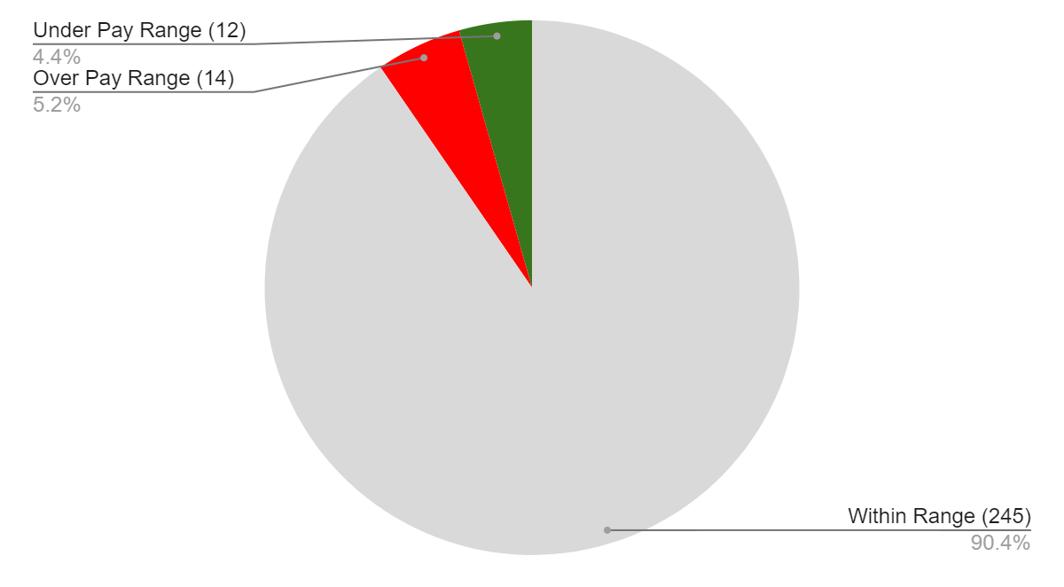
5 Compensation Study Findings
271 AP Positions Analyzed
$99,389*: Funding Needed to bring all greens to within pay range
*Funding needed on annual basis to maintain adjusted salaries

Slide 16
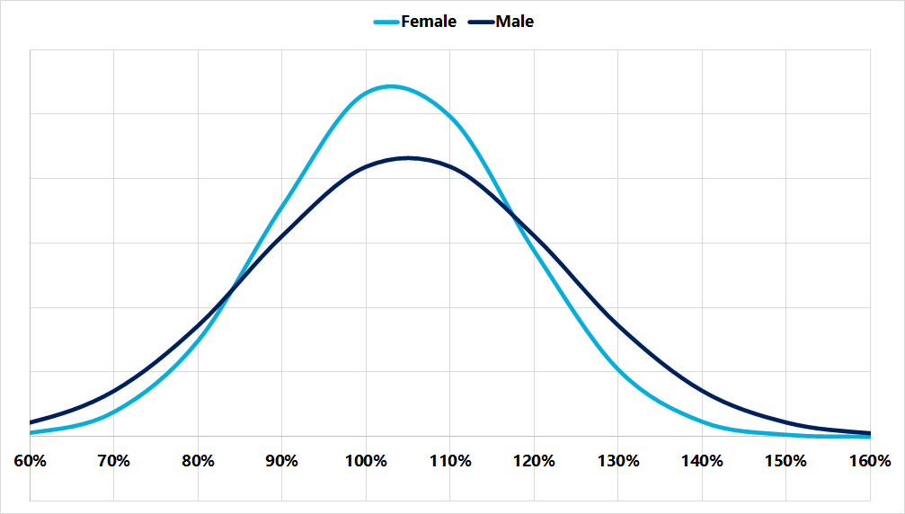
5 Gender Equity Findings
APC Compensation Study: Methodology, Key Findings and Recommendations
Compa-ratio distributions have an average of 103% ± 1% for women and 105% ± 2% for men; the difference between these distributions is not statistically significant (p = 0.30)

Slide 17
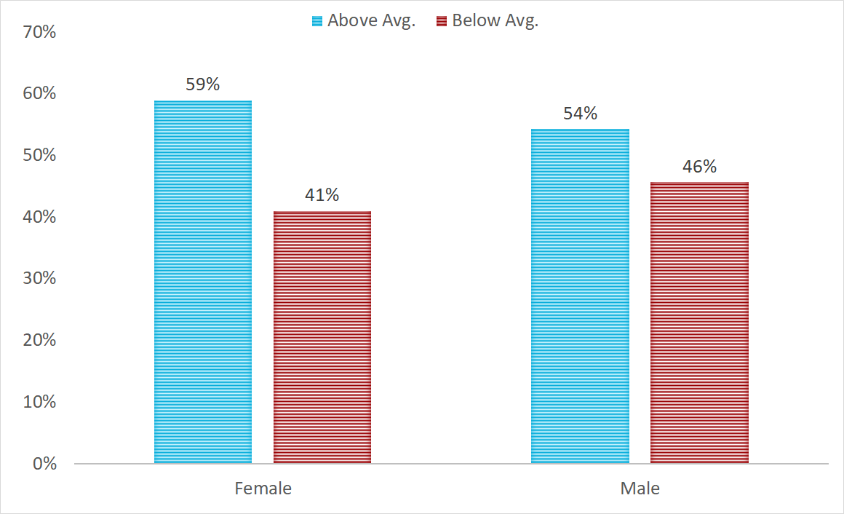
5 Gender Equity Findings
APC Compensation Study: Methodology, Key Findings and Recommendations
Of the 245 employees “in range,” the majority (139) were above range somewhat.
The 12 “below pay range” employees were on average only 4% below.

Slide 18
Processes & Recommendations Informed by Compensation Study Findings
06
WIG 3: Increase Employee Satisfaction

Slide 19

6 Processes & Recommendations Informed by Compensation Study Findings
Achieved a systemic, yet individualized look at compensation across Administrative Professionals
Discussed the far-reaching impacts of our work on interrelated processes
The following slides provide brief summaries from our committee on areas directly related to our work on the compensation study, with recommendations on processes moving forward

Slide 20

6 Adhering to the Equal Pay for Equal Work Act
Provides encompassing protections for employees from discrimination in pay, with all employers in Colorado legally required to comply
Analyzed the compensation study workbook for instances of gender equity issues amongst employees identified in the same positions (previously discussed in Findings)
Made recommendations (details following) on developing a clearcut promotion process for Administrative Professional employees

Slide 21

6 Administrative Professional Promotion Process
No clearcut promotion process for Administrative Professional employees
Recommend that HR create an Administrative Professional promotion process that is adhered to for all internal postings of job promotions in which only internal candidates are being considered
Promotion process should become a part of the search and screen manual, and adheres to the mandates of the Equal Pay for Equal Work Act

Slide 22

6 Individual Compensation Study Reports
Comparing two Administrative Professional employees directly on the measure of compensation is enormously difficult
Few instances of “apples to apples” comparisons
Recommend a new approach to informing employees of the results of the compensation study
Draft HERE of individual compensation study reports

Slide 23

6 Individual Compensation Study Reports
Individualized compensation study reports prepared for each Administrative Professional employee over 0.5 FTE
More meaningful understanding of where they stand compensation-wise
Compensation study workbook should be vetted and maintained on a regular basis by the compensation committee
Individual reports provided to employees on an annual basis
Employees will have the ability to also view the full results of the workbook through accessing a physical copy that will be made available in the library, or through CORA record request

Slide 24

6 Merit-based Increase Process
Merit salary increases for Administrative Professional employees should be consistent with employee evaluation outcomes
Employees whose performance is rated at or above satisfactory to be eligible for merit increases when funding has been allocated for salary increases
When merit-based increases are available, current compensation study data on Administrative Professional employees who are compensated above pay band as receiving a scaled percentage of merit increase so as to prevent a widening gap in compensation

Slide 25

6 Prioritizing Equity and Parity Increases
The President holds discretion over specific annual budget requests for the purpose of addressing equity and parity issues for Administrative Professionals
Equity increases are intended to reduce or eliminate salary disparities among existing and new employees
Parity increases address the competitiveness of CSU Pueblo salaries with that of employees in comparable roles at other institutions
Compensation study provides updated data and tracking measures on existing equity and parity issues
Provides budgetary data needed for the President to make such a request

Slide 26

6 Process for Administrative Professionals to Contest Individual Compensation Study Findings
Individual requests from AP employees to either learn more about their individual compensation study reports or to contest findings
One individual in Human Resources will be the primary point of contact on the compensation study
HR liaison will relay the request to the compensation committee, who will meet on a monthly basis to review any individual requests or petitions
After review of the individual request, a response will be provided to the individual with committee findings and recommendation

Slide 27
6 Sustainability Plan of the Compensation Study
Compensation Study Conducted on Annual Basis with updated CUPA-HR Annual Reports
APC Comp Cmte continues to support HR on a monthly basis to review new or updated jobs, and assess contentions.
Individual Compensation Study Reports provided to each AP employee over 0.5 FTE on annual basis. Timed with APR.
Membership to CUPA Associated and CUPA-HR Annual Reports Purchased annually ($3,200) to keep data updated.

Slide 28
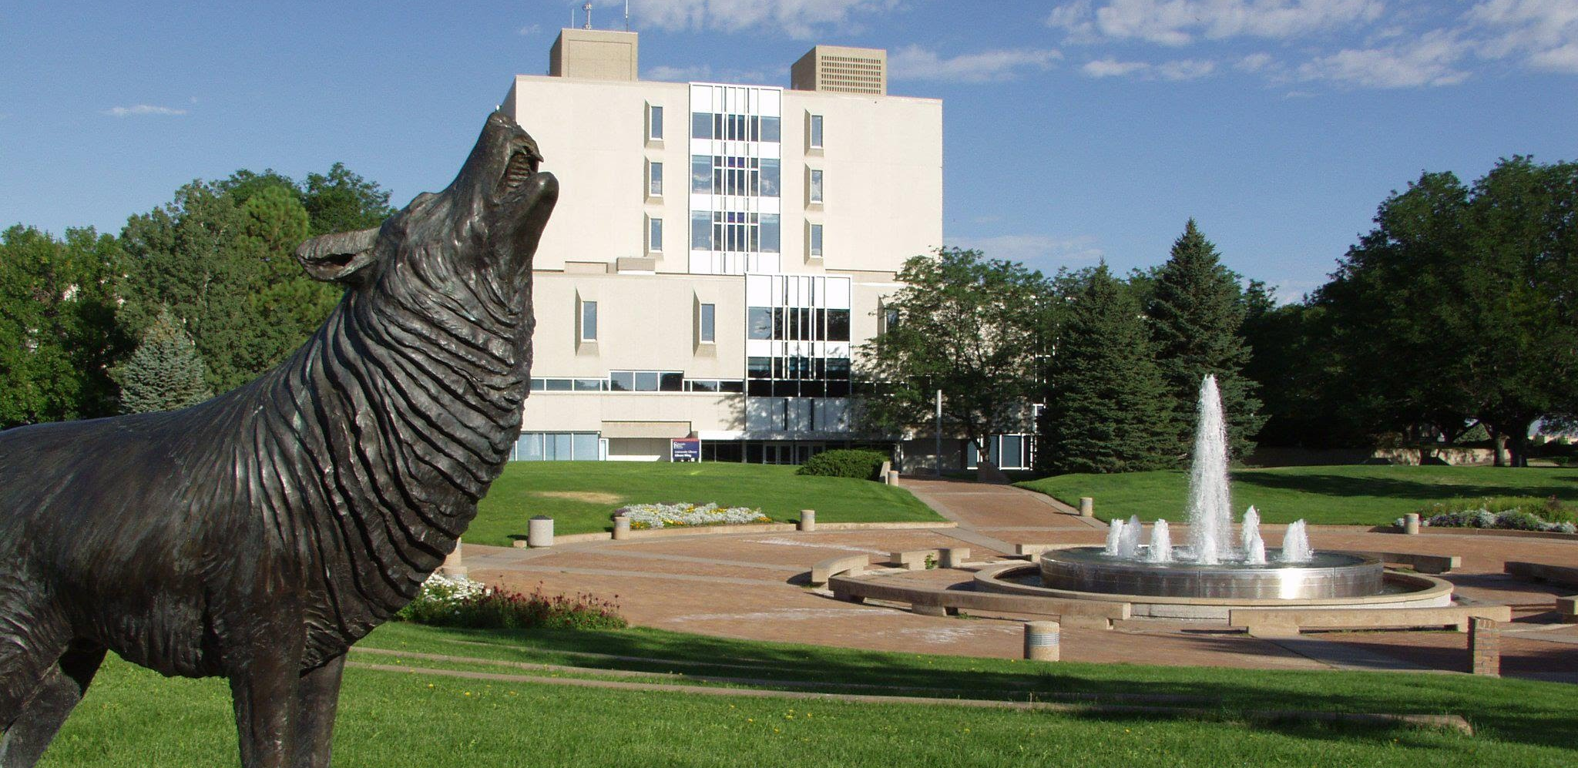
Questions?

